Slide 1
Client
Tools
Consultancy
The slides contain brief notes
Some slides are animated and are best viewed in Slide Show Mode
A Good UX
How To Make It Happen
Niels Gebauer
Director
Client Tools Consultancy
ngebauer@ClientTools.com.au
EAE 4023, UNITE 2010
Tuesday, 9:15 am
May 25th 2010

Slide 2
Client Tools Consultancy
Specializes in client interface solutions to customers using EAE and AB Suite systems
The company aim is to provide products and services that add value to EAE and AB Suite by enriching the End User Interface capabilities
Founded May 2007
Located in Adelaide, South Australia

Slide 3
Agenda
A good UX
How Microsoft supports a good UX
How CTC enables you to utilize the latest Microsoft Technologies
A good UX

Slide 4
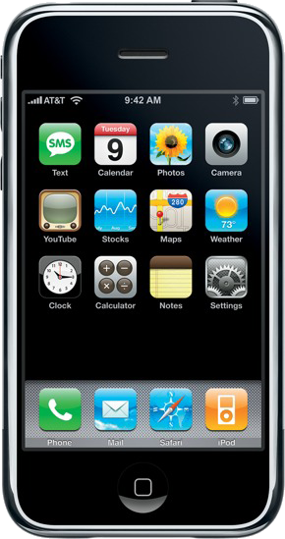
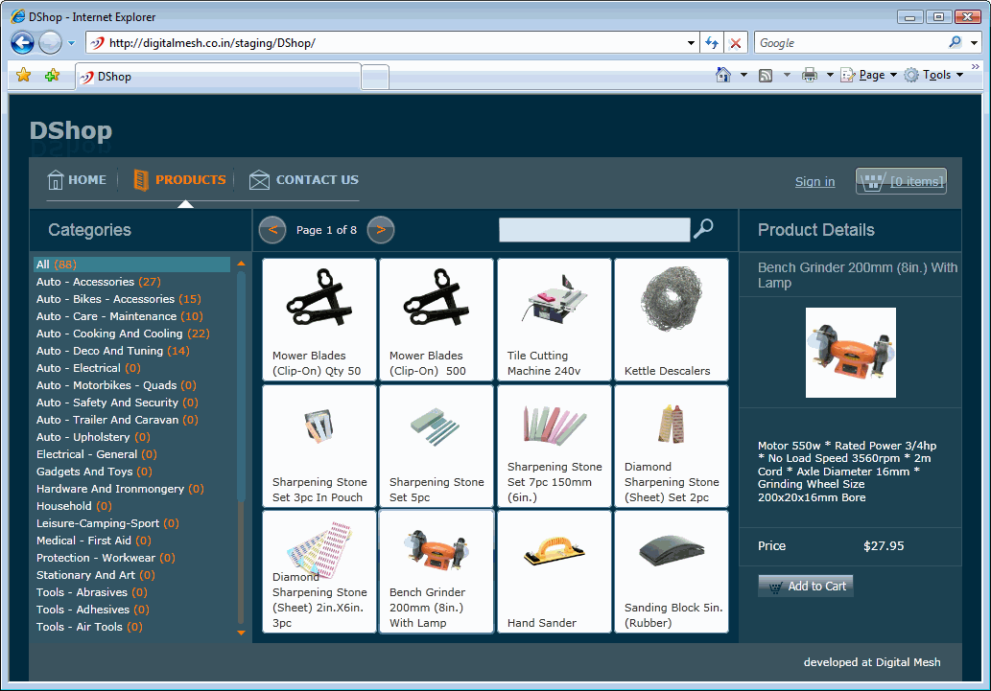
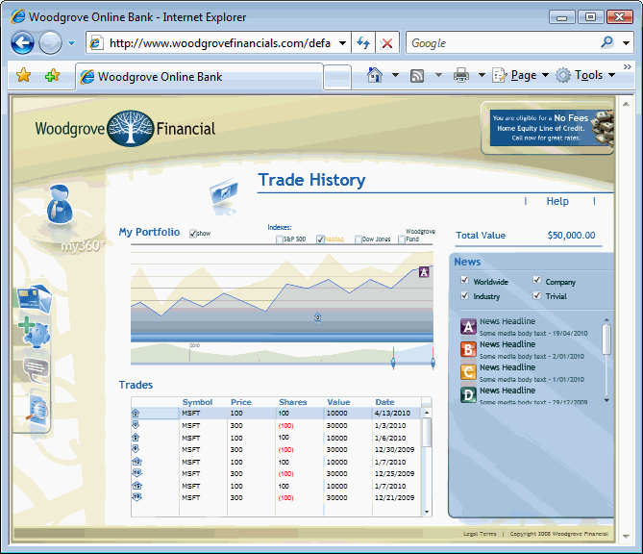
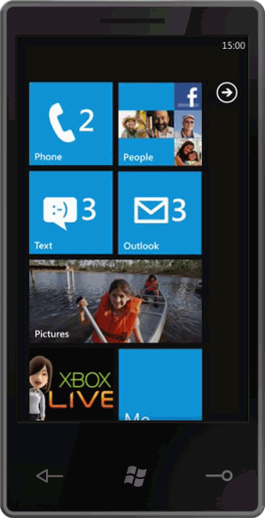
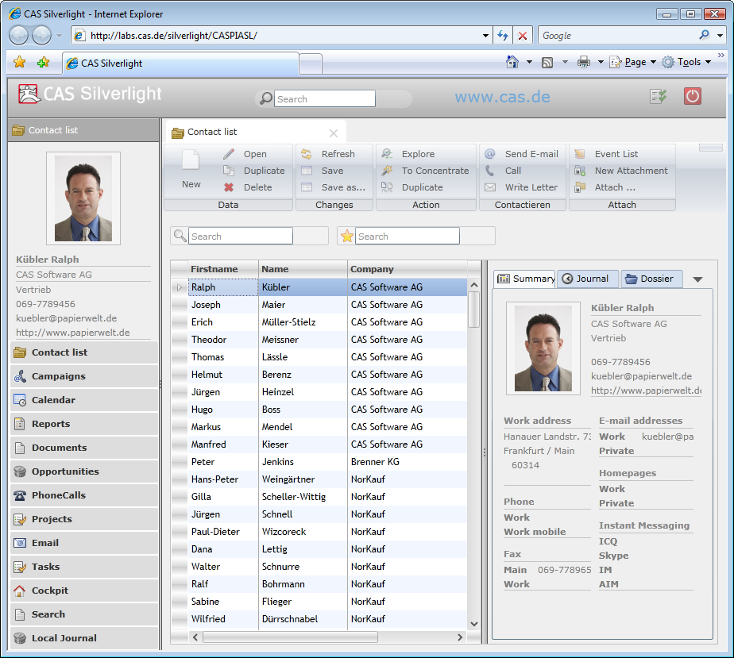
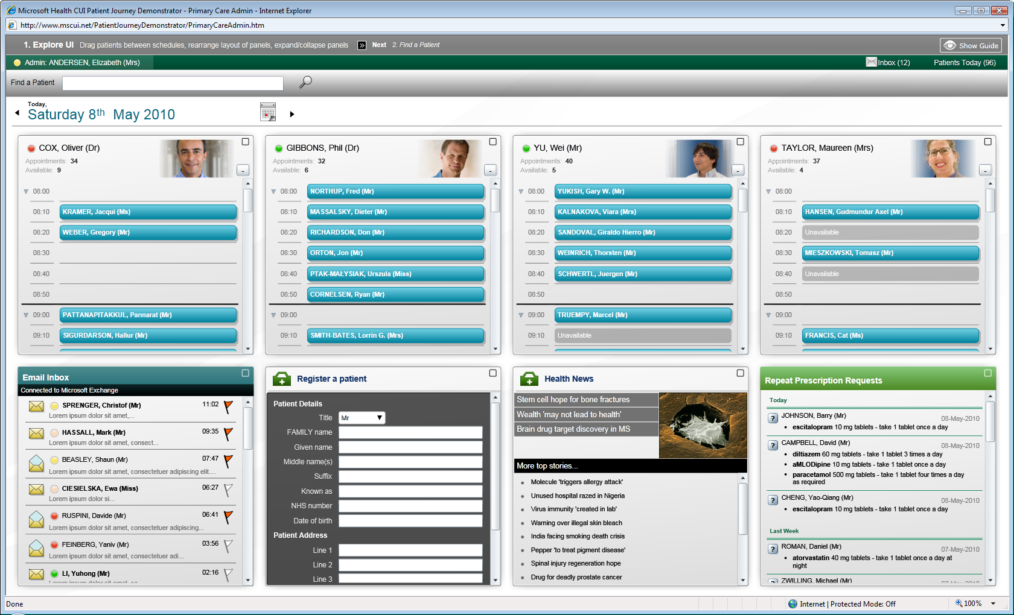
Notes:
Those who make Commercial products, whether it is devices or software applications, knows the importance of providing a Good User Experience, and the same applies equally to the business applications created with EAE and AB Suite.

Slide 5
Successful Software Projects
One important measurement of a successful software project is:
User Adoption
How to achieve that:
Provide a Good User Experience

Slide 6
Criteria for Good User Experience
provide feedback to user actions
behave with consistency
behave in a familiar way
be obvious and efficient
be responsive and perform
be elegant
Notes:
These are some of the qualities of a good user experience:
The interface should provide feedback to user actions such as roll-over behaviour, click behaviour and cursor icons. For example, when the user submits the forms, the button should indicate it has been clicked, and the cursor should change to a wait cursor. The user is then in no doubt that the form has been submitted.
The interface must behave in a consistent and familiar way. Be obvious, intuitive and efficient. The end user is frustrated when an interface is not obvious and intuitive. It should perform well and look good.
These are obvious things, but how often do you come across an application that doesn’t do this?
With traditional UI technologies such as WinForms and HTML, it is often not easy to do these things and if you want to do it well, the implementation costs can be high.

Slide 7
Agenda
A good UX
How Microsoft supports a good UX
How CTC enables you to utilize the latest Microsoft Technologies

Slide 8
Microsoft UI Technologies
Windows Desktop Clients
Browser Environment
Windows Phone 7
Based on .NET and XAML
Similar programming model
Same skills set
Rich User Experience
The most significant technical attributes for achieving a good UX:
XAML - Declarative mark-up language
Data Binding
Controls
Notes:
The latest in UI technologies from Microsoft are WPF and Silverlight.
WPF is for the Desktop and Silverlight is for Web applications and Mobile devices.
Silverlight is a free plug-in to the browser and runs on a variety of different browsers.
According to Microsoft, Silverlight is now installed on around 60% of all internet connected workstations.
Recently Microsoft announced that Silverlight is the Application Platform for Windows Phone 7.
WPF and Silverlight are both based on .NET and XAML (an XML based Mark-up language). They have a similar programming model, require the same skills set and both provide a Rich User Experience.
But most importantly, they both make it easy to create User Interface applications that deliver a good User Experience.
The three most significant technical attributes of WPF and Silverlight for achieving a Good UX:
The declarative XAML mark-up language,
Data binding,
A large number of controls.

Slide 9
XAML
XML-based mark-up language that declaratively specifies the application's appearance
XAML
<TextBlock Text="Customer Name" FontFamily="Arial"
FontSize="16" FontWeight="Bold"/>
<TextBox x:Name="CUSTNAM" FontFamily="Arial" FontSize="16"
FontWeight="Bold" Text="{Binding NAM, Mode=TwoWay}"/>
Reduces/eliminates the need for programming
Notes:
This is an example of XAML. It is the language for specifying the look and feel of the interface.
It is a very powerful and expressive language that reduces, and in most cases, eliminates the need for actual programming.

Slide 10
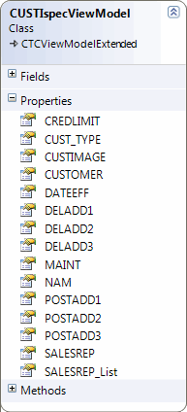
Data Binding
Copies values from the data objects into controls
Copies changes back to the data objects
XAML
<TextBlock Text="Customer Name" FontFamily="Arial"
FontSize="16" FontWeight="Bold"/>
<TextBox x:Name="CUSTNAM" FontFamily="Arial" FontSize="16"
FontWeight="Bold" Text="{Binding NAM, Mode=TwoWay}"/>
Data Binding done declaratively in XAML reduces/eliminates the need for programming
Notes:
Data binding is the process that associates the controls with their data elements.
As the example here shows, data binding can be specified declaratively in the XAML specifications of the controls, and when it is done this way, it reduces, and in most cases, completely eliminates the need for application logic.
Data binding automatically copies the values from the data elements into the controls, and copies them back again when the user changes the values.
When used correctly, it also helps separate the UI from the application logic.

Slide 11
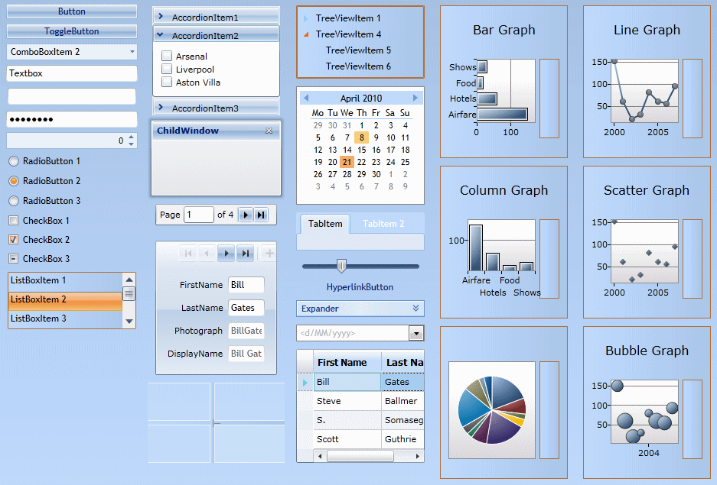
Controls
60+ Rich Controls
Notes:
This is a sample of the Silverlight controls. Similar controls are also available with WPF.
There are more than 60 controls, providing plenty of choice to enhance the UI.
The controls you see here are the typical business application type controls, but Silverlight and WPF also include many more exotic controls for projection, spinning and media/video controls. The use of some of the controls could allow you to greatly expand the functionality of your system where at the moment you may be extracting data to another product to provide for example, graphical output.
What you see here is the default look and feel. Straight out of the box you actually get a decent interface.

Slide 12
Modern Rich Controls
Using modern controls
increases productivity
reduces input errors
reduces improper data analysis
reduces support and training cost
increases user satisfaction
Notes:
Using modern controls provides more than just a good look. There are some real measurable benefits such as the ones mentioned here.

Slide 13
Application Design Pattern
Model-View-ViewModel pattern (M-V-VM)
Model
(Business Objects)
ViewModel
(Presentation
Objects)
View
(UI)
Transaction Request
Data Binding
Transaction Response
Data Binding
EAE/AB Suite Ispecs
.NET
XAML
Developer
Designer
Separates UI from Application/Presentation logic
Facilitates automatic Data Binding
Enables Designers and Developers to work side by side
Notes:
To get the full benefits of WPF and Silverlight, it is important how you design and structure the application.
A recommended design pattern is the Model-View-ViewModel pattern.
To put this in context:
- The View (or the Form) represents the XAML specifications
- The Model represents the Ispecs on the host system, whether it is EAE or AB SUITE
The ViewModel is the client side representation of the Ispecs.
When a View is submitted to the host system, the Data Binding copies the data from the controls into the ViewModel. The ViewModel is then sent as a transaction to the host system. The response received from the host system is transformed into the ViewModel and the Data Binding copies the data into the controls on the View.
A design pattern like this allows complete separation of the UI specification from the application and presentation logic, making it easier to maintain.
It facilitates the automatic Data Binding, which leads to less programming.
But very importantly, it also enables UI Designers and Developers to work together using different tools without stepping on each other’s toes.

Slide 14
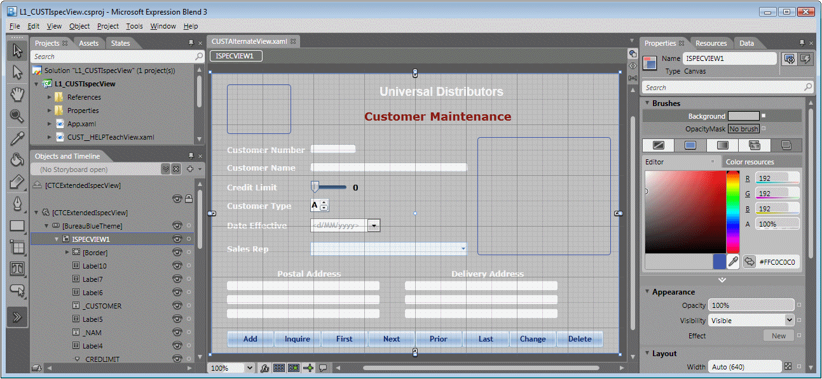
UI Designer Tools
Microsoft Expression Blend
Notes:
Microsoft provides the Expression Blend product which is a tool specifically for User Interface Designers who have the skills to create good User Interfaces.
This is an example of Expression Blend with one of the Ispecs from the Sample system getting a facelift and a change in layout.
Expression Blend integrates really well with Visual Studio which is the Developers tool.

Slide 15
Agenda
A good UX
How Microsoft supports a good UX
How CTC enables you to utilize the latest Microsoft Technologies

Slide 16
Desktop Applications for Microsoft Windows Presentation Foundation
Internet/Intranet Applications for Microsoft Silverlight
For EAE and AB Suite
Data Services Interface for Microsoft Windows Communication Foundation
Internet/Intranet Applications for Microsoft ASP.NET incl. AJAX
Notes:
CTC provides 4 generators.
The WPF and Silverlight Generators are for the latest technologies from Microsoft.
There is also the ASP.NET Generator. It can generate either standard ASP.NET applications or ASP.NET applications with AJAX.
And a generator for WCF Data Services is the latest in the product line.
All generators work with EAE and AB Suite.

Slide 17
Demo
Silverlight Application
CTC
Configurator
CTC
Generator
UI
Application

Slide 18
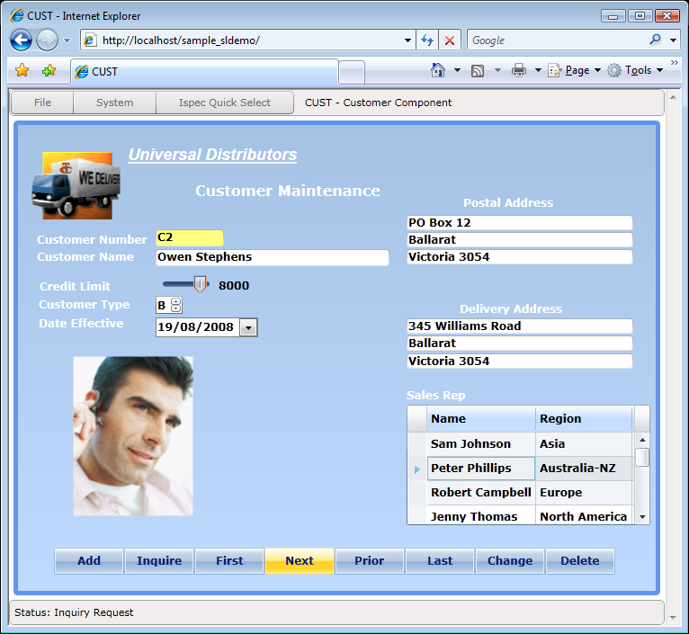
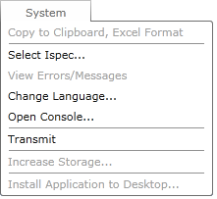
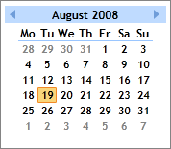
Notes:
This is an example of the CUST ispec from the well known Sample system.
We see the use of different controls, such as the date picker with the dropdown calendar instead of the normal text box, and Slider, and Up/Down, and a DataGrid with multi columns instead of a list box.
There is also a main menu with dropdown selections, which users expect in modern systems.
Also notice the rollover effect and highlighting of the button.

Slide 19
Generate Environment
CTC
Configurator
CTC
Config
XML DB
EAE
Model DB
Plug-In Generators
EAE
Developer
CTC ASP.NET Generator
CTC WCF Services Generator
CTC WPF Client Generator
CE
Generate
Environment
CTC
Plug-In
Generators
Silverlight
Client
Generator
AB Suite
Developer
AB Suite
Model DB
Generated
Solution
Notes:
This shows the Generate Environment and how the CTC Generator fits in with the normal Component Enabler Environment.
We are all familiar with the Component Enabler Generate Environment and how all of its various generators just plug-in to this.
That’s a great architecture, as it provides just one generic interface between the EAE and AB Suite Development Environments and all types of User Interface generators.
The CTC generators are no different. They are normal plug-in generators to the CE Environment, and as such, you run the CTC Generators in exactly the same way as you run all other Component Enabler Generator.
However, the architecture and design of the CTC Generators is very different. This is needed to achieve the high degree of flexibility that’s necessary to generate rich User Interface applications.
The Configurator is an essential part of the solution. The Configurator provides a graphical interface to configuring the behavior of the generators, which gives you control over what is generated.
The generators are all inclusive generators, so when the generate is finished, you are done. There is nothing more to do. There is no post-processing or any manual steps required to further manipulate the generated forms. You just run the User Interface.
And that makes the whole process simple, reliable and repeatable.
----
The generators are completely external to EAE and AB Suite. They do not modify your EAE or AB Suite environment. So, if you, for example, downloaded and installed one of the free evaluation versions, and later decide to uninstall it, nothing will have changed in your environment.

Slide 20
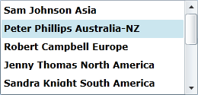
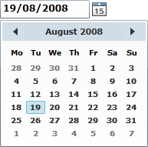
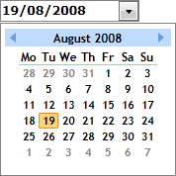
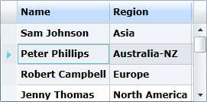
Demo
Replacing Painted Controls
CTC
Configurator
CTC
Generator
UI
Application
Notes:
The following sequence shows how easy it is to enhance the painted forms and improve the user interface.

Slide 21
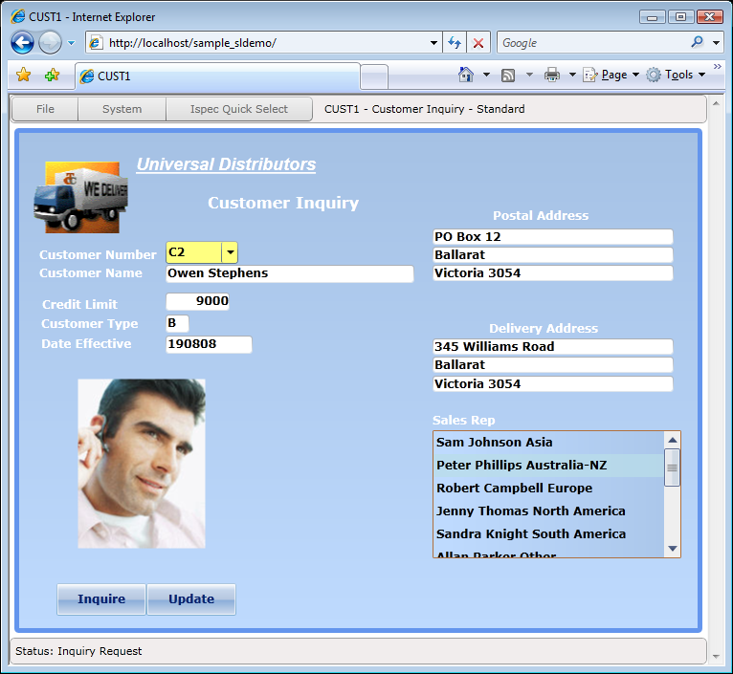
Notes:
This is the default look and feel of a standard Customer Inquiry screen from the Sample system without any enhancements.

Slide 22
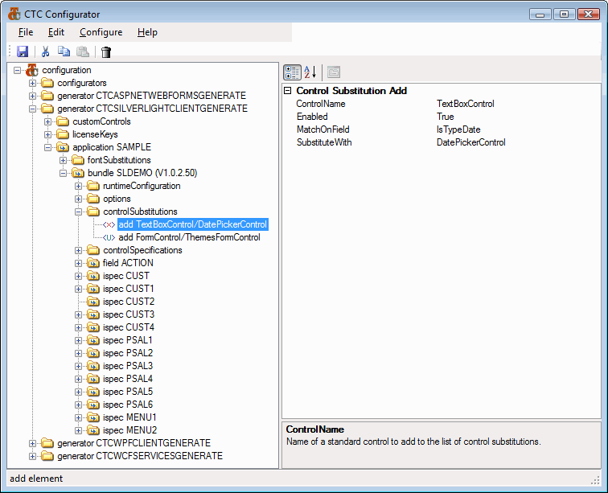
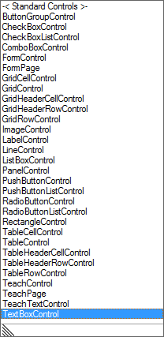
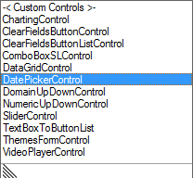
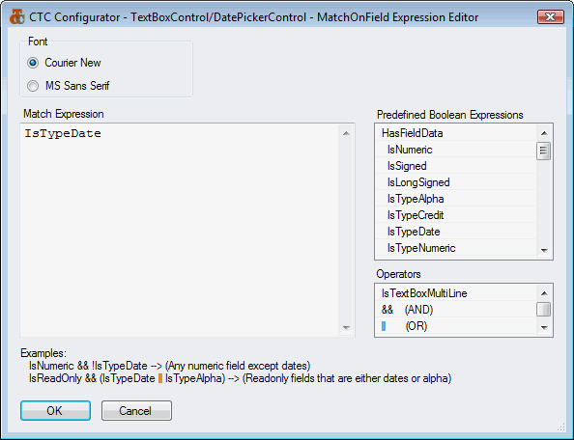
Notes:
Here the Date Field has been replaced with a drop down Calendar control.
The calendar appears when the Dropdown is clicked; when a date is selected by clicking, the TextBox is updated with the selection.
The CTC solution is based on the principle that you should be able to specify any required enhancements to the user interface with little and in most cases no programming at all. The CTC Configurator is a central tool for achieving this.
In this example, a Control Substitution has been added to the configuration of the bundle. The TextBox Control is selected from the dropdown list and substituted with the DatePicker Control selected from a dropdown list.
If this substitution of the TextBox is added at the bundle level, it will be applied to all TextBoxes on all ispecs within this bundle. But in this case, the substitution is to be applied only to date fields. Therefore a ‘Match On Field’ condition is specified using the expression editor. With this editor, you can specify conditions as complex as needed, but, in this case we only need to match on fields that are of type date.
That’s all it takes to replace date fields with a Calendar control with no programming involved.

Slide 23
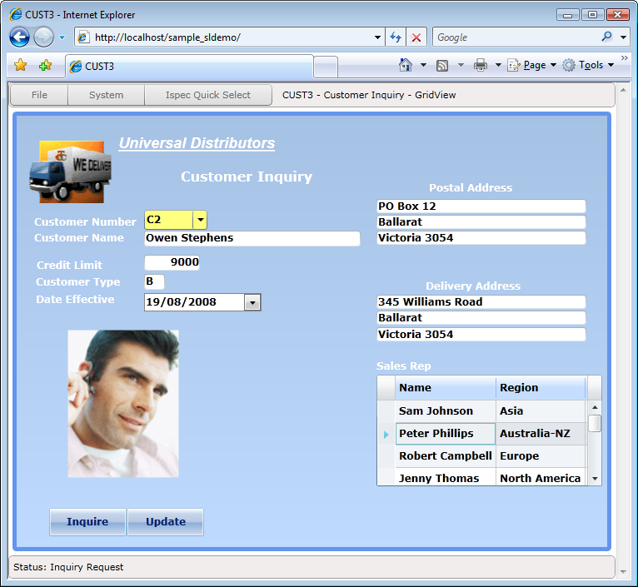
Notes:
In this screen, the standard List Box is replaced with the standard Silverlight and WPF DataGrid control.
The DataGrid control is very popular and is very often used instead of the default ListBox because it allows for a much better user interface than the ordinary ListBox.
You can specify things like column headings, column sorting and colors on individual rows.

Slide 24
Third Party Controls
Notes:
The User Interface Technologies from Microsoft are very popular and have attracted a large number of third parties that offer many different and exciting controls for ASP.NET, WPF and Silverlight.
The CTC solution is designed to allow you to take advantage of any of these controls to suit your requirements.
Each of these controls is different. They all have their own unique set of properties and therefore a translation of the controls as you paint them in EAE and AB Suite to which ever third party control you would like to use is necessary.

Slide 25
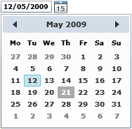
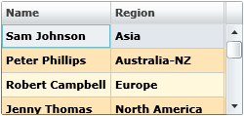
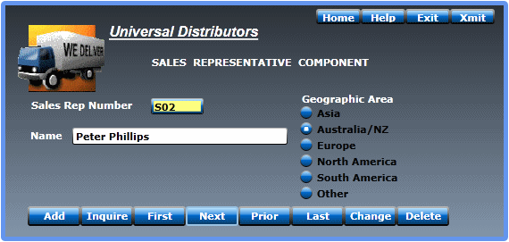
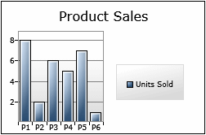
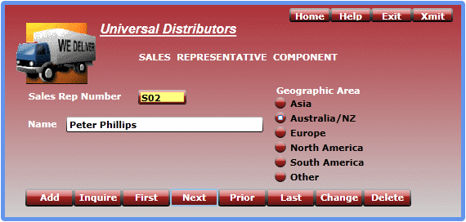
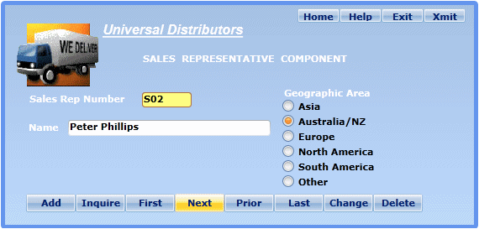
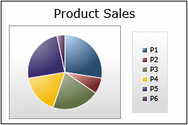
Custom Controls
Date Picker
DataGrid
VideoPlayer
Column Sorting
Column Resizing
Column Reordering
Themes
Slider
Charting
6000
7000
UpDown
Chart Types
Column
Bar
Pie
Line
Area
Bubble
Scatter
11 Themes
Credit Limit
Customer Type
Additional Controls
Additional custom controls can be
added by customers or CTC.
Notes:
Custom Controls in the CTC generators enable this mapping.
A number of Custom Controls are included with the Silverlight and WPF generators when you install them. Some are shown on this slide.
The ASP.NET generator includes a different set of custom controls.
You are not limited to just these custom controls. The CTC solution allows you to add your own Custom Controls.
The source code of these Custom Controls is provided with the generator. You therefore have a starting point for creating your own controls.
Contact CTC if you need assistance in creating additional custom controls to suit any specific requirements.

Slide 26
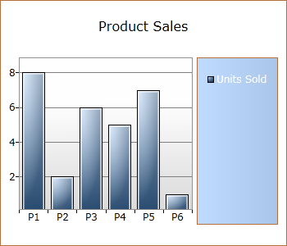
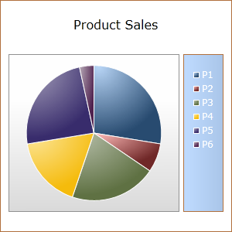
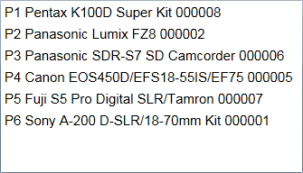
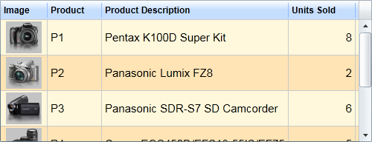
Demo
ListBox DataGrid Chart
CTC
Configurator
CTC
Generator
UI
Application

Slide 27
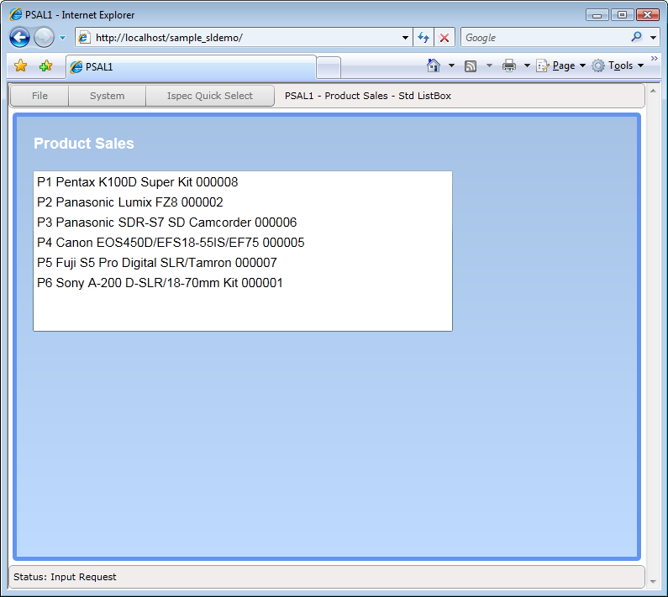
Notes:
This ispec displays the product sales as a standard dynamic ListBox.

Slide 28
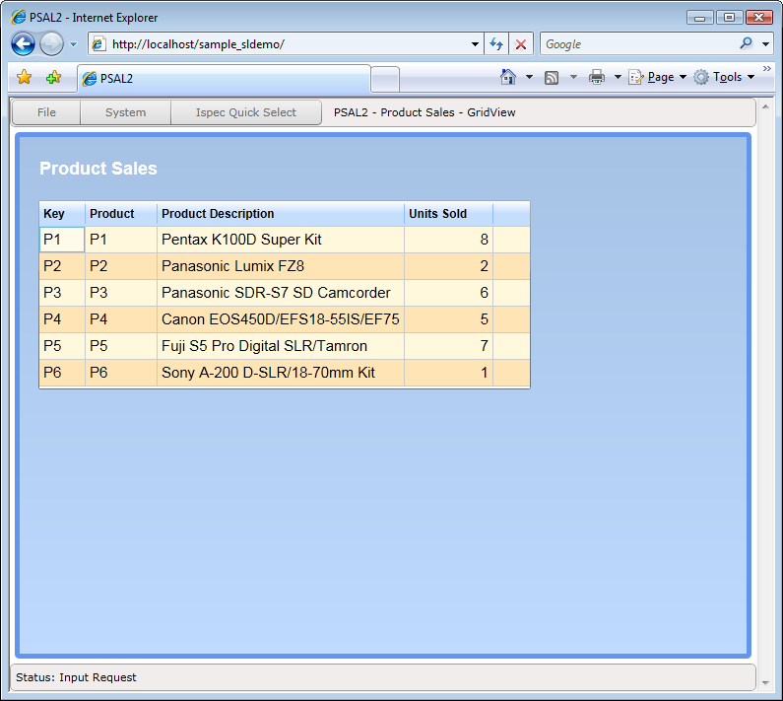
Notes:
Using the CTC Configurator, the same list can be replaced with the DataGrid to show the data in a column formatted list.
The DataGrid is a control with many capabilities. One useful capability is column sorting, which allows the user to sort the data by clicking on the column headers.

Slide 29
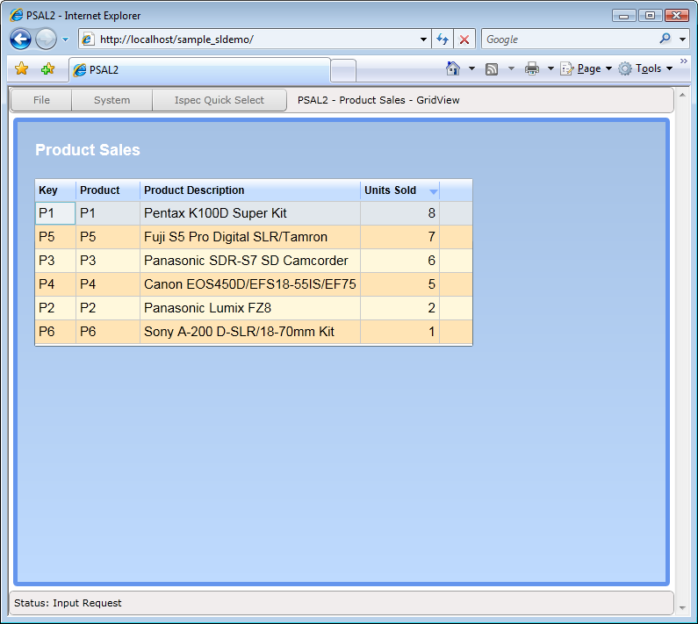
Notes:
Here the end user has sorted the data in descending order on “Units Sold”, to easily see which product is selling best.
Using a control like this enables your users to see the data how they need to see it, with no additional programming to make that happen.

Slide 30
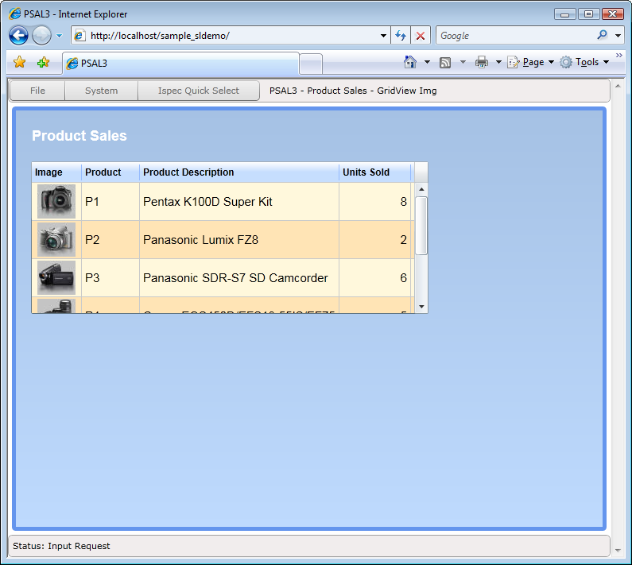
Notes:
You can also include images in the DataGrid. Here the Product Number is used as the key to show product images.

Slide 31
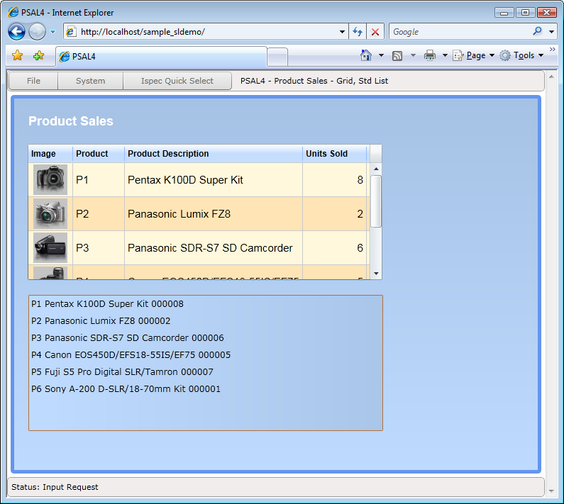
Notes:
A second list box has been added as a copy of the first one.

Slide 32
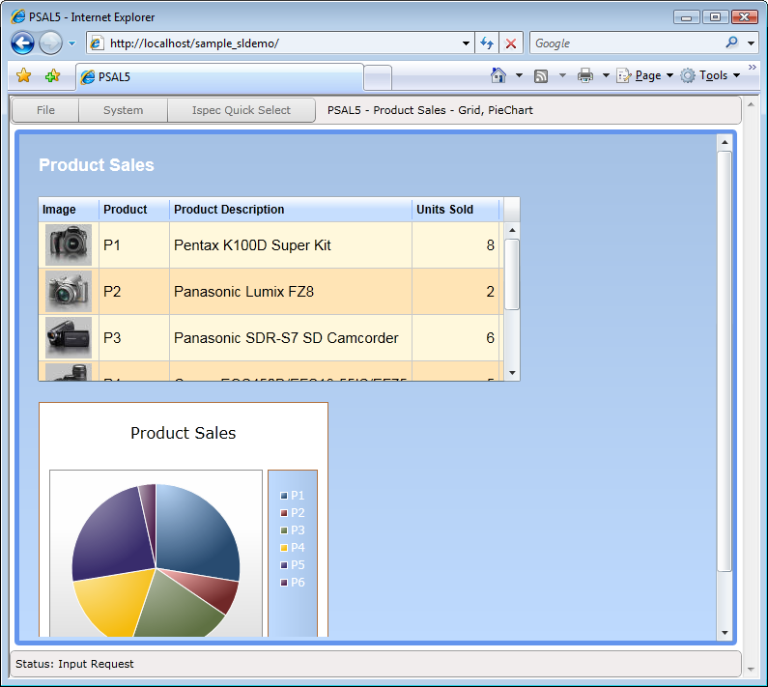
Notes:
And then the second list box is replaced with the Silverlight Chart control.
This is done without any programming, just configuration.
The host EAE and AB Suite application is completely unaware how the list is presented, it just supplies the list.

Slide 33
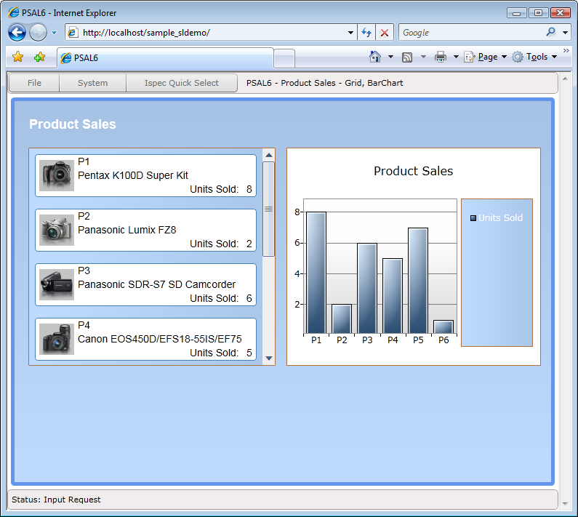
Notes:
This slide shows another way of presenting the same information. This is a list box where the layout of each row has been specified using a data template. And the chart is shown as a bar chart.

Slide 34
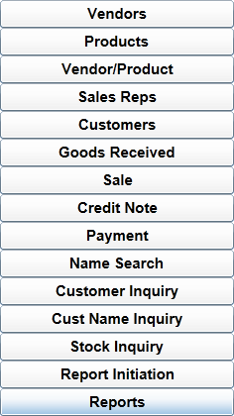
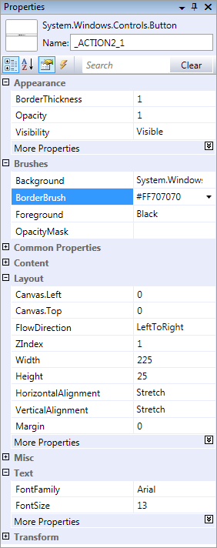
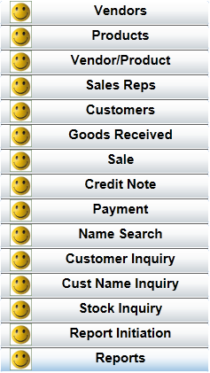
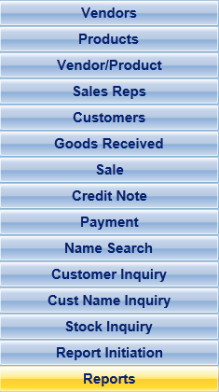
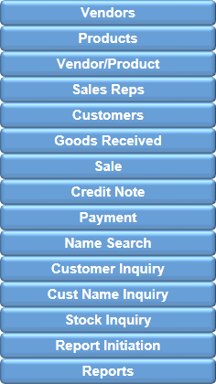
Customizing Controls
Any property available on the controls can be specified.
Notes:
Each of the UI controls for Silverlight, WPF and ASP.NET has a large number of properties available. This provides a high degree of customization to suit specific requirements.
However, the controls you paint on the forms in EAE and AB Suite only allows usage of a small subset of these properties.
Using the CTC Configurator will allow you to specify any of the properties on any control to suit your User Interface.
This can be simple things like Background color, Background Images, or Borders. Simple things can have a huge effect on how the application is received by the users.

Slide 35
Demo
Control Properties
CTC
Configurator
CTC
Generator
UI
Application

Slide 36
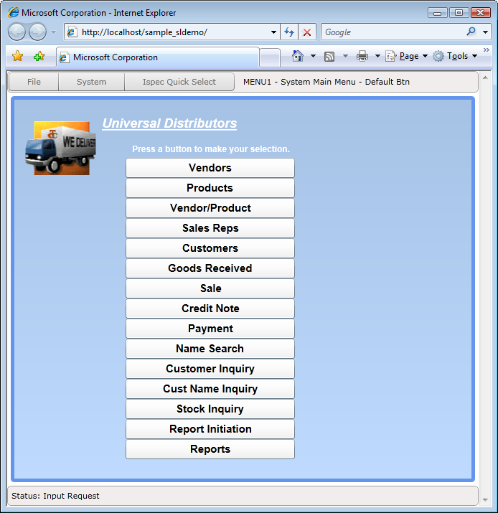
Notes:
This is the look and feel of standard default generated buttons.
The buttons look flat because the buttons within EAE and AB Suite are specified with a white background color which overwrites the default behavior of the button.

Slide 37
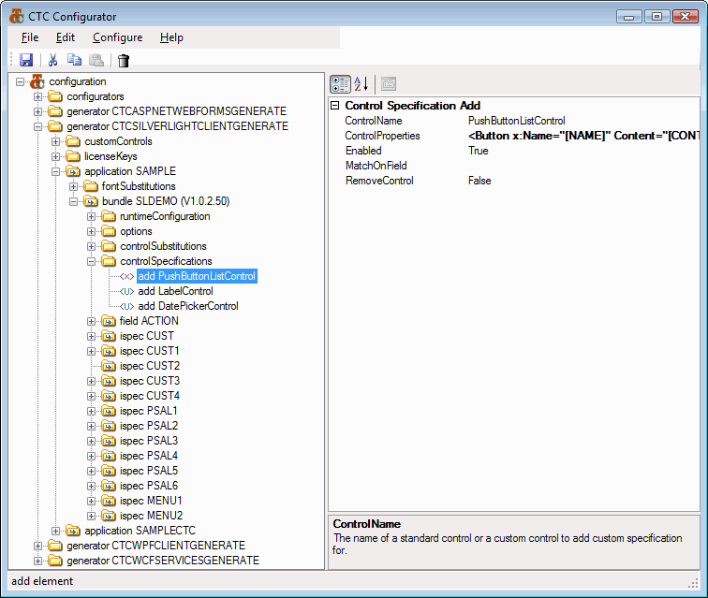
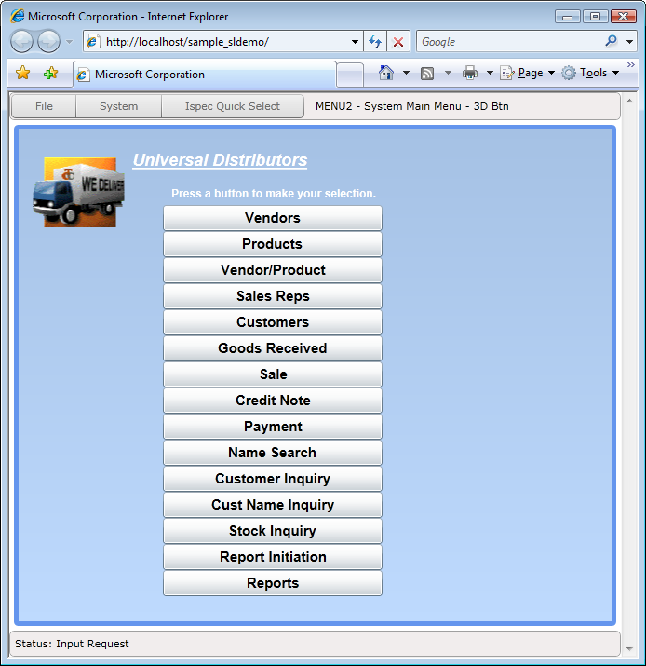
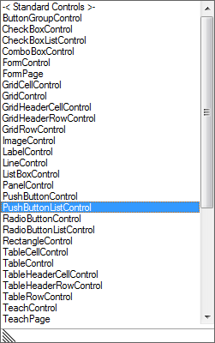
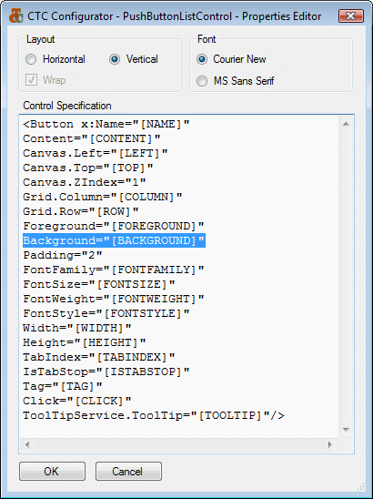
Notes:
Here we see the buttons with a 3D effect. This is achieved by removing the white background color from the buttons. This then allows Silverlight and WPF to show their default look and feel.
Using the Configurator, a control specification of the Button control has been added to the configuration. This has been added high in the hierarchy at the bundle level, which means the specifications of the button will be applied to all buttons on all ispecs within this bundle.
The Push Button control is selected from the dropdown list as the control to configure.
The Properties Editor is opened to edit the properties of the control. What is shown is the default template of the control as it will be generated. This template is provided automatically by the system, so the template is then edited to suit the requirements.
You can add and remove properties as necessary.
The square brackets represent the information coming from the form painted in EAE and AB Suite.
Allowing you to edit the template like this means you have full control over exactly what is being generated.
The 3D look is simply achieved by removing the background color property from the button.

Slide 38
Generate Options
Eliminate manual processes
Automatically installs infrastructure files
Automatically creates virtual directory
Automatically resets IIS to avoid generate errors
Automatically builds generated application
Automatically upgrades infrastructure files
Runtime options
Keep Session Alive
Prevent double transmit
Date Format
User own code
Create Custom Code Module
External Forms Painter
M-V-VM Design Pattern
Create Alternate View
Notes:
All CTC Generators include a large number of options all aimed at making it very flexible and easy to use.
They are all configured using the Configurator.
Some options are aimed at eliminating manual processes that you do today. Others are aimed at making the runtime of the generated application more efficient. And there is an option that allows you to add user own code to any of the generated forms.
An option is provided for adding a Custom Code Module to any generated form. This, for example, allows you to add your own specific code to a form to do things like setting properties on controls depending on values returned from the host system, or validate user input before the data is sent to the host system.
Another option provided allows you to use external form painters such as the Microsoft Expression Blend to paint an alternate view of the forms.
This may be useful if you have User Interface Designers in your team and want to go beyond what you have painted in EAE or AB Suite.
This is possible because the WPF and Silverlight generators are using the Model-View-ViewModel design pattern. Using this option, ensures the generator does not overwrite the alternate views.

Slide 39
CopyFrom as Grid Option
Notes:
This shows the effect of the CopyFrom as Grid option.
With this option, a CopyFrom area can be generated as a DataGrid and it will automatically pick up the label headings and generate them as column headings on the grid.

Slide 40
Multi View: side-by-side
Notes:
Each of the generators from CTC includes an advanced ViewController, which controls the displaying of the forms, and the communication to the EAE and AB Suite host systems.
The ViewController can allow multiple views into the host systems. It can show multiple forms within the same system or forms from different systems. Multi Views can be shown side-by-side as you see here or they can be set up as tabs.

Slide 41
Multi View: tabs
Notes:
Multi Views can also be set up as tabs.
The views can be for ispecs within the same EAE and AB Suite system or they can be to ispecs from different systems.

Slide 42
Runtime Configuration
Configure Runtime Parameters
Graphical interface for runtime configuration
Drop down selections
Extensive help text for each parameter
Automatic update of the Web.config/App.config file
Notes:
All the runtime parameters can be configured using the CTC Configurator which is more convenient than editing the runtime config file with Notepad.
It also means you keep all the configurations, for the generator and the runtime, in one place and use just one tool for maintaining the configuration.

Slide 43
WPF Runtime Environment
.NET 3.5
Unisys CE .NET
WPF Application
IIS Web Server
(optional)
WPF
Application
Web Server
WPF
Application
Files Download
Generated
WPF
Application Files
WPF
Application
EAE/AB Suite
Host Systems
WPF
Application
Transactions
Local Storage
Downloaded
WPF
Application Files
Notes:
This is an overview of the runtime architecture of a generated WPF Solution.
WPF is the replacement for WinForms and runs on the desktop. One of the issues with desktop applications is the deployment of the application files. The CTC solution allows you to take advantage of the Click-Once mechanism provided by Visual Studio for distributing the WPF application.
In addition, the CTC Solution also provides the option to automatically download and cache all application files on the workstations that are required at runtime. This includes the generated forms and images.
When a new version of the forms and other files has been generated, they will automatically be downloaded to the workstations. This requires a web server to be available.

Slide 44
Silverlight Runtime Environment
Silverlight browser plug-in
Silverlight
IIS Web Server
Unisys CE .NET
Data Services Interface
Silverlight
EAE/AB Suite
Host Systems
Silverlight
Internet
Intranet
Silverlight
Web Server
Local Storage
Generated
Silverlight
Application Files
Downloaded
Silverlight
Application Files
UI Application runs locally on the client
Files are automatically downloaded and cached locally
Only data is exchanged with the web server
Notes:
This is an overview of the runtime architecture of a Silverlight Solution.
Silverlight is a plug-in to the browser and it is automatically downloaded from Microsoft and installed when the end user for the first time enters the URL to the Silverlight application. The generated Silverlight application will automatically download all application files such as forms and images and cache them locally until new forms have been generated.
From an application distribution point of view, this environment is much easier to manage.
The generated Silverlight application is very efficient. The application runs locally on the client workstation and utilizes the resources on the workstation rather than the web server. The messages between the client and the web server are as small as possible.

Slide 45
ASP.NET Runtime Environment
Browser
IIS Web Server
Unisys CE .NET
ASP.NET Application
Browser
EAE/AB Suite
Host Systems
Browser
Internet
Intranet
Browser
Web Server
Generated
ASP.NET
Application Files
UI Application runs on the web server
Local caching depends on browser settings
Form controls and data is exchanged with the web server
Notes:
For comparison, this is an overview of the runtime architecture of an ASP.NET Solution.
With ASP.NET, the application runs on the Web Server, which makes the web server a potential bottle neck.
The messages that flow between the client and the web server are much bigger. A response from the web server includes all the html code of the form as well as the actual data.

Slide 46
Silverlight versus ASP.NET
Silverlight advantages:
More efficient
Forms are downloaded once only and cached until changed
Only data is exchanged with the Web Server
Uses less resources on the Web Server
Forms are processed and rendered locally on the Client
Better end user experience
Desktop-like experience
Immediate feedback to user actions
Better response time
Fewer skills required
No HTML, JavaScript or AJAX skills required
XAML skills required
Transaction Size (Sample System CUST Ispec) in Bytes | ASP.NET | Silverlight
Client to Web Server (Request Message) | 1121 | 782
Web Server to Client (Response Message) | 17568 | 2352
Notes:
When you compare Silverlight with ASP.NET, there are some major advantages of using Silverlight.
Silverlight is more efficient, and uses less resources on the web server, leading to a better End User experience.
The response time with a Silverlight application is much better. Shown here is a comparison of the message size of a transaction from the CUST ispec on the Sample system. The size with Silverlight is substantially less than ASP.NET, which leads to better response times.
The programming model for Silverlight applications is less complex and requires less skills.

Slide 47
WCF Services Generator
Create Services Interface for Microsoft Windows Communication Foundation
Based on the Microsoft WCF LOB Adapter SDK
Enables a Services Oriented Architecture (SOA)
Provides Web Services interface based on Industry Standards
Integrates with BizTalk and .NET Apps (WinForms, WPF)
Highly customizable
Notes:
The latest addition to the CTC portfolio of products is the WCF Services Generator, released mid May.
This generator enables your EAE and AB Suite systems to participate in a Services Oriented Architecture that is so essential for successful integration of disparate systems. Because it is using the Microsoft WCF Line-Of-Business Adapter SDK, your EAE and AB Suite systems can integrate directly with systems like BizTalk without having to go via web services.
Other well know industry packages such as Oracle, SAP and PeopleSoft are also using the WCF LOB Adapter SDK as their Data Services interface.

Slide 48
In Summary…
The CTC Solution
Modernizes your EAE and AB Suite systems with little effort
Allows you to take advantage of the latest in UI Technology from Microsoft
Allows unrestricted access to the capabilities of the chosen technology (ASP.NET, WPF, Silverlight and WCF)
No training required to use the CTC generators
Free trial versions available for download
www.ClientTools.com.au
Notes:
The CTC solution allows you to modernize your EAE and AB Suite systems to take full advantage of the latest UI Technologies from Microsoft, such as Silverlight, WPF and WCF Services.

Slide 49
Client
Tools
Consultancy
www.ClientTools.com.au

