Slide 1




Client
Tools
Consultancy
The slides contain brief notes
Some slides are animated and are best viewed in Slide Show Mode
A Good UX
Making It Happen
with the CTC Silverlight Solution
Niels Gebauer
Director
Client Tools Consultancy
ngebauer@ClientTools.com.au
EAE 4004, UNITE 2011
Tuesday, 8:00 am
May 24th 2011

Slide 2





Client Tools Consultancy
Specializes in client interface solutions to customers using EAE and AB Suite systems
The company aim is to provide products and services that add value to EAE and AB Suite by enriching the End User Interface capabilities
Founded May 2007
Located in Adelaide, South Australia

Slide 3
Agenda
The CTC Silverlight Environment
  Generate Environment
  Runtime Architecture
Demonstrations
  Sample Silverlight Interface
  Custom Controls
  Copy From Grid
  Multiple Open Ispecs
  Client-Side Printing
  Out-Of-Browser
The CTC Silverlight Environment
  Generate Environment
  Runtime Architecture
Demonstrations
  Sample Silverlight Interface
  Custom Controls
  Copy From Grid
  Multiple Open Ispecs
  Client-Side Printing
  Out-Of-Browser

Slide 4
Generate Environment
CTC
Configurator
CTC
Config
XML DB
EAE
Model DB
Plug-In Generators
EAE
Developer
CTC ASP.NET Generator
CTC WCF Services Generator
CTC WPF Client Generator
CE
Generate
Environment
CTC
Plug-In
Generators
Silverlight
Client
Generator
AB Suite
Developer
AB Suite
Model DB
Generated
Solution
Notes:
First, there is the Generate Environment.
We are all familiar with the Component Enabler Generate Environment and how all the different User Interface generators just plug-in to that.
This is a great architecture, as it provides just one generic interface between the EAE and AB Suite Development Environments and all the different User Interface generators.
CLICK
The generators from CTC are no different. They are normal plug-in generators to the CE Environment, and as such, you run the CTC Generators in exactly the same way as you run all other Component Enabler Generators.
However, the architecture and design of the CTC Generators is very different in order to achieve the high degree of flexibility that’s necessary to generate Rich User Interface applications.
One of the major differences is the CTC Configurator. It provides a graphical interface allowing you to configure the behavior of the generators, which gives you control over what is generated.
With EAE and AB Suite, you paint a general look and feel of the forms, not for any specific User Interface. With the CTC Configurator, you then specialize the forms for a specific User Interface Environment, such as Silverlight, WPF or ASP.NET. For example, with the CTC Configurator, you add in Date Pickers, Data Grids and other features that are specific to the User Interface you are targeting.

Slide 5



Runtime Architecture of Generated Silverlight Application
Silverlight
Silverlight
IIS Web Server
Unisys CE .NET
Generated UI Application
Silverlight
EAE/AB Suite
Host Systems
Internet
Intranet
Silverlight
Silverlight Application
IIS
CTC Silverlight View Controller
CTC Silverlight CE Services
Data Items
Views Navigation
Forms Download
Forms Display
Event Handling
Multiple Ispecs
CE Proxy
Connect/Transact
Ispec Model
List data
Status Line
Session State
Host
Communication
Unisys Component Enabler
Local Storage
Downloaded
Ispec Views &
View Models
Views/Forms Download
Generated
Ispec Views &
View Models
Notes:
The runtime environment is a traditional three tier architecture. We have:
End User workstations on which Silverlight is running. Silverlight is a plug-in to the browser and it installs itself automatically when a user the very first time, browses to a web site that deploys a Silverlight Application.
A Web Server with IIS. This is where you deploy the generated Silverlight Application to. On the web server, we have the Unisys Component Enabler that handles all the communication with the Host EAE or AB Suite systems.
and finally we have the host system, which can be any computer on which you currently run your systems.
CLICK
This gives a little more detailed look at some of the components involved.
Component Enabler is not required to be installed on the end user workstations. Instead, a CE Proxy module gets automatically downloaded with the main Silverlight application. This implements the necessary functions required to communicate with Component Enabler on the Web Server.
On the Web Server, there is a CE Services module that implements the services that are necessary for the Proxy module to communicate with Component Enabler and the host system.
The CTC Silverlight View Controller on the client side manages everything to do with the forms/views, such as automatic downloading, displaying, handling of various events and many other things including managing multiple open ispecs. This also ensures the session with the Web Server never times out. There is nothing more irritating to End Users when they run a web based application, and they lose data just because the session times out.

Slide 6
Silverlight Runtime Environment
Efficient Environment
  Automatic forms distribution
  Forms are downloaded once only and cached until changed
Minimum resources required on the Web Server
  Forms are processed and rendered locally on the Client
  Only data is exchanged with the Web Server
End-User Experience
  Desktop-like experience
  Immediate feedback to user actions
  Better response time
Easy to Learn
  No HTML, JavaScript or AJAX skills required
  XAML skills required
Transaction Size (Sample System CUST Ispec) in Bytes | ASP.NET (AJAX) | Silverlight
Request Message (Client to Web Server) | 1,121- (1,121) | 782
Response Message (Web Server to Client) | 17,568- (16,837) | 2,352
Notes:
The Silverlight Environment is a very efficient environment:
Forms are distributed automatically and cached locally on the end user workstation. So, on any subsequent use of a form, it is loaded directly from the local disk.
Forms are processed locally on the client and only data is exchanged with the web server. A form is rendered once only when it is opened and on every subsequent transaction, the controls on the form are updated directly with data from the transaction.
Compared with ASP.NET, a Silverlight application uses much less resources on the web server. ASP.NET is a very resource hungry environment because it processes and re-creates the forms on the server on every request and this easily leads to the web server becoming a bottle neck.
As a comparison, this slide shows the size of a transaction of the CUST ispec from the Sample system. The size of the request being sent into the server is about 30% smaller for Silverlight. The size of the reply message coming back from the server is about 85% smaller for Silverlight. That’s because the Silverlight application only sends the actual data back, not the entire form. So that is a significant difference and this is one of the reasons the users will experience a much better response time with Silverlight.
Processing the forms locally on the client, as Silverlight does, leads to a better End User experience, such as a desktop like experience with immediate feedback to user actions and the users get a great response time.
The programming model for Silverlight applications is less complex and requires less skills than ASP.NET.

Slide 7
Agenda
The CTC Silverlight Environment
  Generate Environment
  Runtime Architecture
Demonstrations
  Sample Silverlight Interface
  Custom Controls
  Copy From Grid
  Multiple Open Ispecs
  Client-Side Printing
  Out-Of-Browser

Slide 8
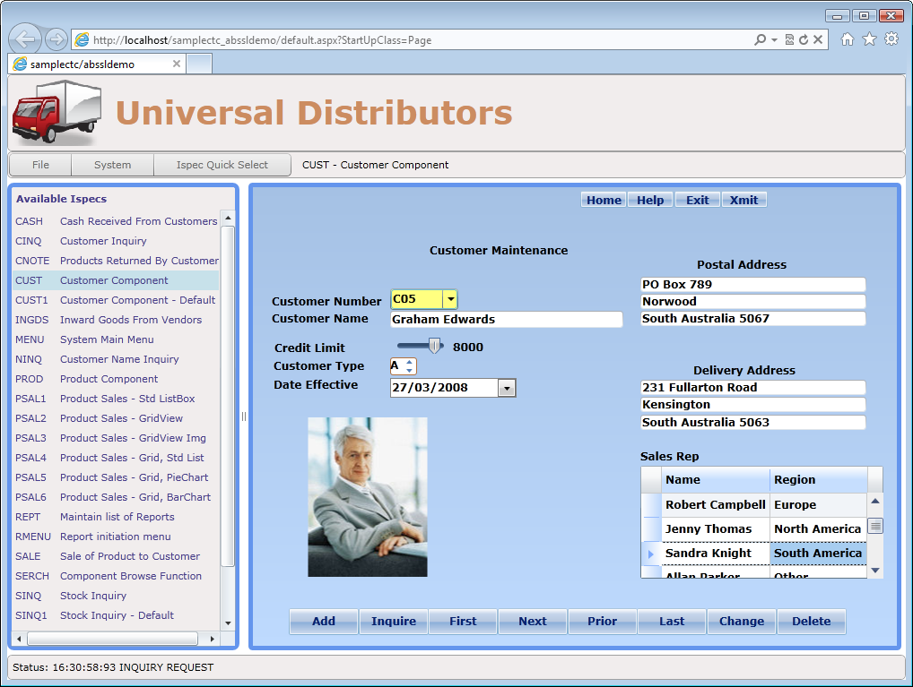
Demo
Sample Silverlight Interface

Slide 9
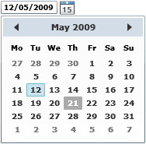
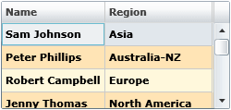

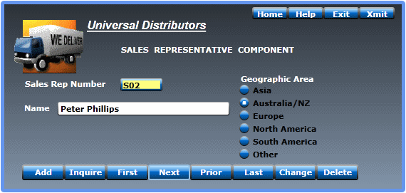

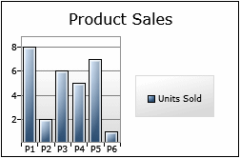
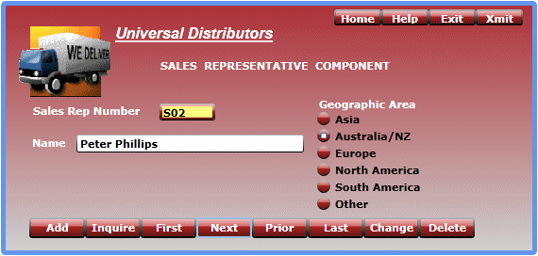
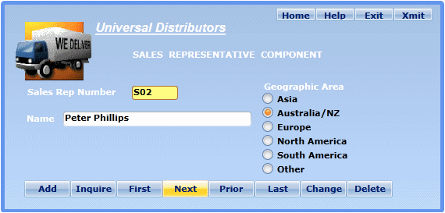
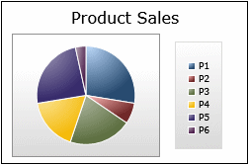
Custom Controls
Date Picker
DataGrid
VideoPlayer
Column Sorting
Column Resizing
Column Reordering
Themes
Slider
Charting
6000
7000
UpDown
Chart Types
Column
Bar
Pie
Line
Area
Bubble
Scatter
11 Themes
Credit Limit
Customer Type
Additional Controls
Additional custom controls can be
added by customers or CTC.
Notes:
Custom controls are an essential part of being able to enhance the forms.
Custom Controls would be used when you want to replace or substitute controls that you have painted on the forms. For example, a DatePicker control can be used instead of a textbox that displays date fields, and a DataGrid control can be used instead of a listbox.
A number of Custom Controls are included with the generator and here on the slide, you see some of them.
You are not limited to just these custom controls. The CTC solution allows you to add your own Custom Controls.
The source code of the Custom Controls is included with the generator and you can use that as a starting point for creating your own controls.
You can also contact CTC who will be happy to assist with creating additional custom controls to suit any specific requirements.

Slide 10

















Third Party Controls
Notes:
Controls from third party tool vendors can be used. There are lots of third parties that offer great controls for ASP.NET, WPF and Silverlight.
The CTC solution is designed to allow you to take advantage of any of these, and add them as Custom Controls, to suit your requirements.

Slide 11
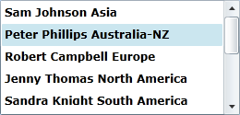
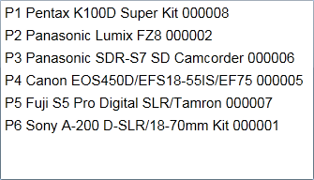
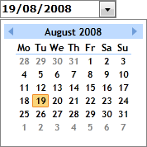
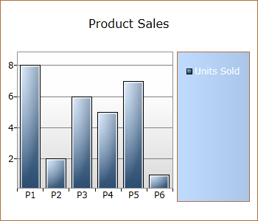
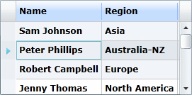
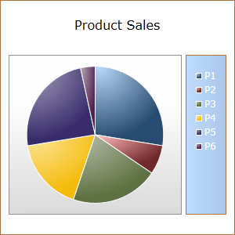
Demo
Custom Controls

Slide 12
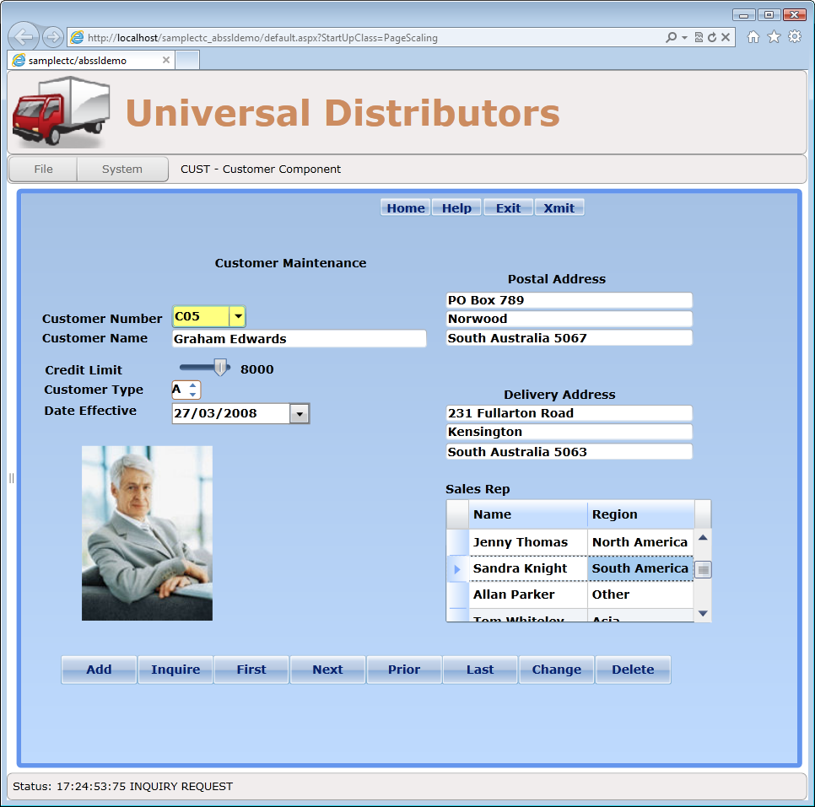
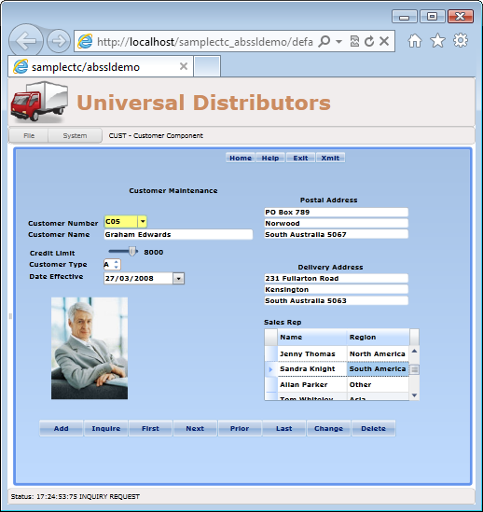
Demo
Scaling
Notes:
Being able to resize and scale the forms is sometimes a requirement from the users.
Scaling is a feature of Silverlight so this is simply achieved by adding a scaling control to the user interface application.

Slide 13
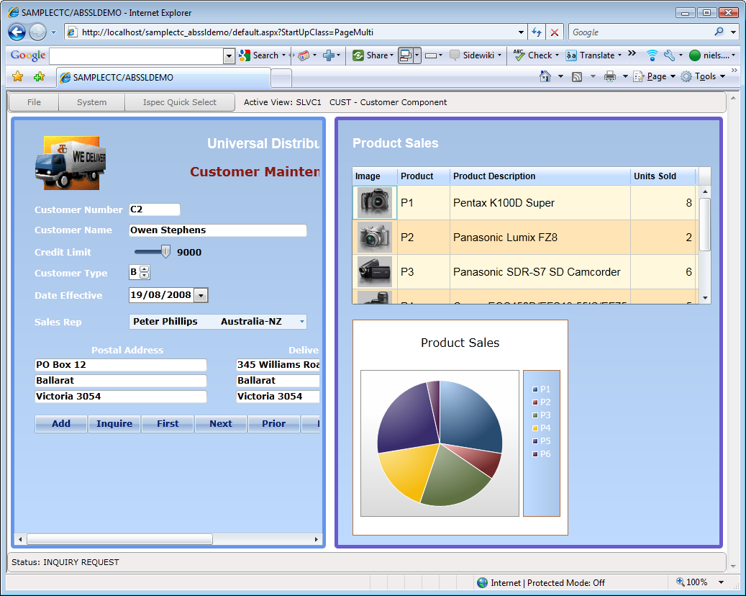
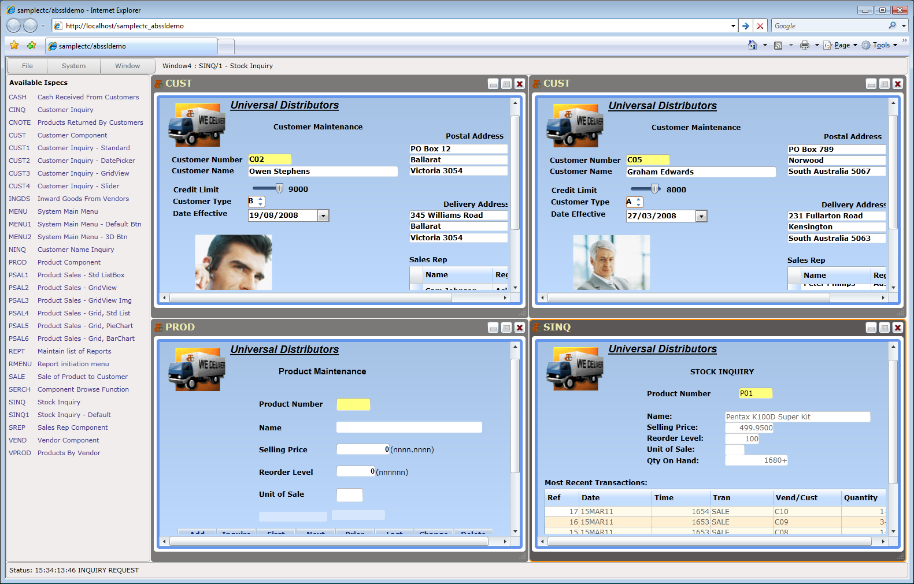
Demo
Multiple Open Ispecs
State Full
Multiple Sessions
Stateless
Multiple Ispecs in One Session
Notes:
The method for accessing multiple ispecs depends on whether your EAE or AB Suite applications are designed and implemented as State Full or Stateless systems.
Basically a State Full system is a system that uses Global Work for storing and maintaining values in between transactions. When that is the case, showing multiple ispecs requires multiple independent sessions in order for the state information in Global Work not to get mixed up.
A stateless system typically uses hidden fields on the form for storing and maintaining values in between transactions. When that is the case, multiple ispecs can be opened at the same time within the same session.
The CTC solution supports both methods.

Slide 14
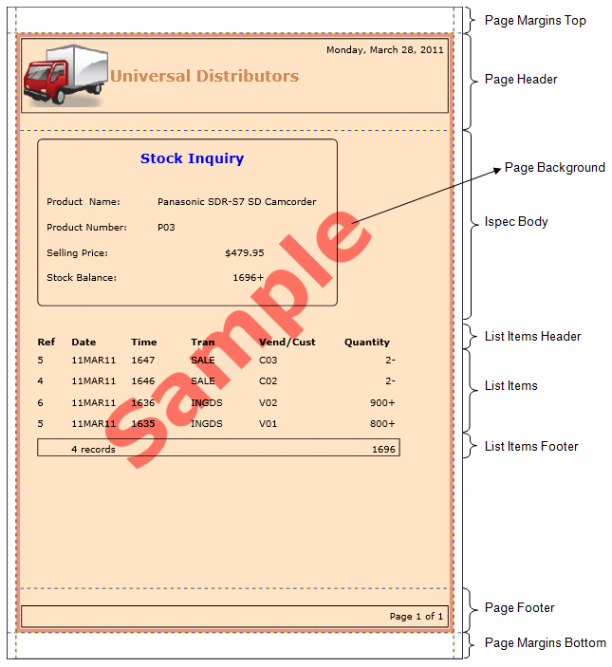
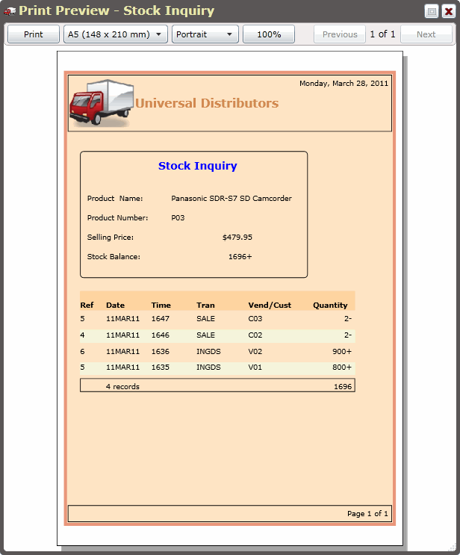
Demo
Client-Side Printing
Ispec Print Control
Page Layout Templates
Print Preview
Notes:
The CTC solution includes a special control for printing ispecs on the client side. This enables printing of ispecs in a format different from the painted forms.
With the Ispec Print control, you can create a template of the page layout.
It provides automatic pagination of lists and CopyFrom Ispecs.
You can include calculated fields such as running total of lists and CopyFrom rows.
And it includes a Print Preview function

Slide 15
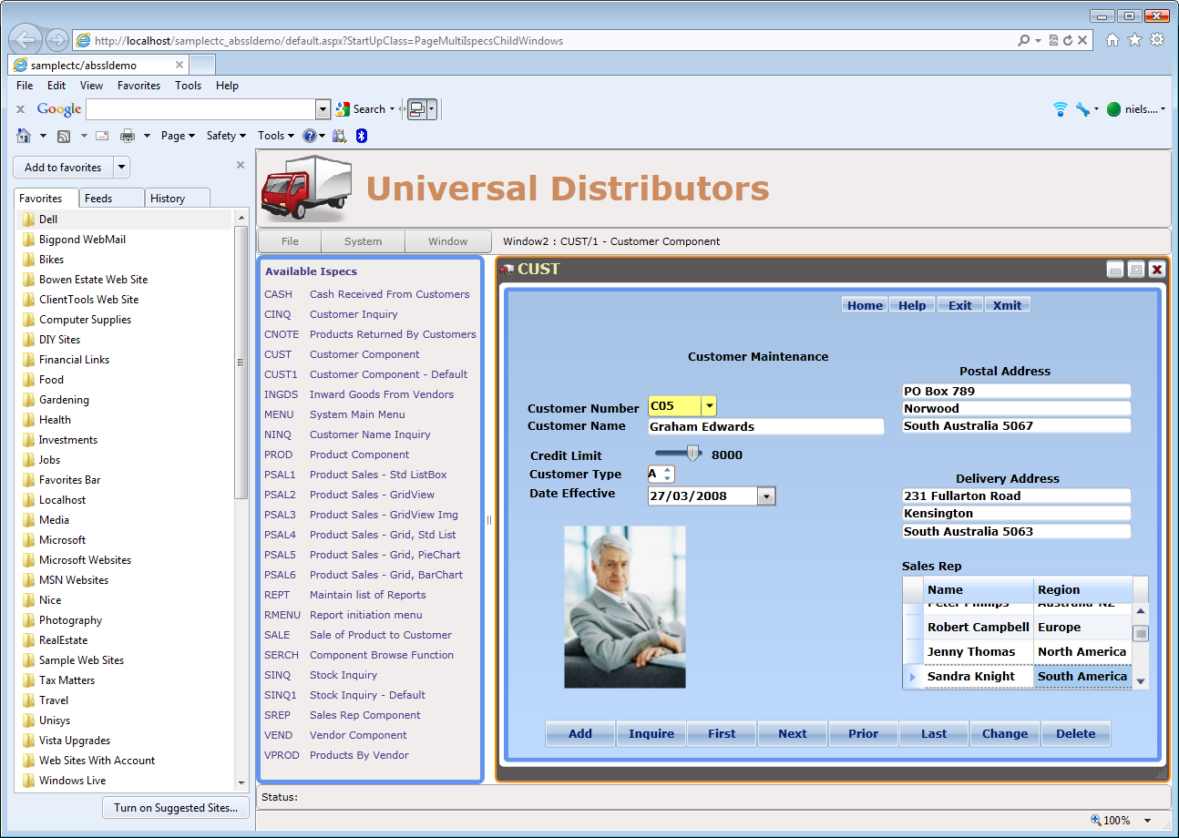
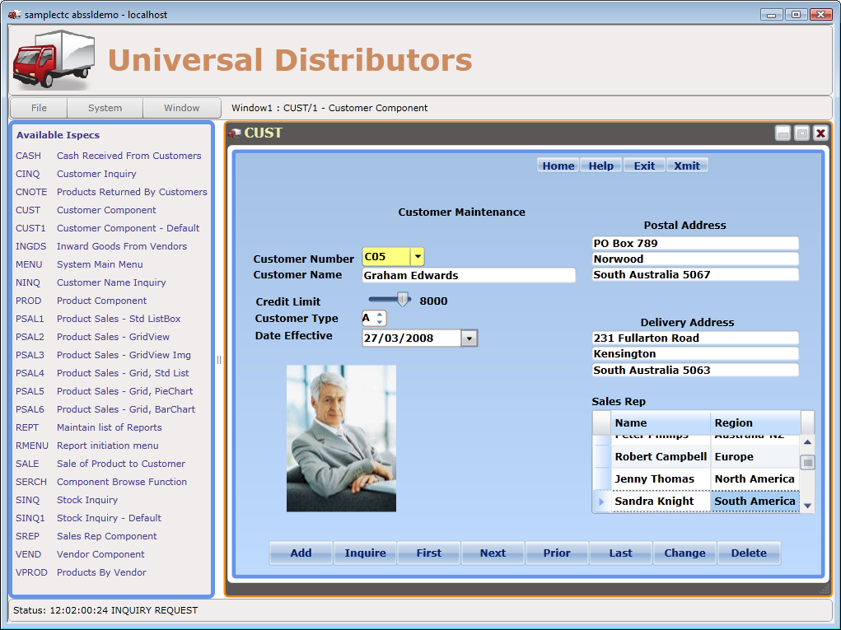
Demo
Out-Of-Browser
In-Browser
Out-Of-Browser
Notes:
Out-Of-Browser is a Silverlight feature that allows the application to be installed on the client workstation and run it as if it is a normal desktop application.
An option in the CTC Configurator allows you to easily enable Out-Of-Browser mode.

Slide 16


Client Reference
Banco Republica del Uruguay – Unisys Uruguay
User Interface modernization project
Replacing Power Builder User Interface solution
EAE system, 2000 Ispecs
In Production
Using most of the features including:
  DatePicker, DataGrid, CopyFrom Grid
  Multiple Open Ispecs (stateless)
  Client-Side Printing
  Out-Of-Browser
Notes:
In 2010 the Bank of Uruguay made the decision to modernize their user interface and use Silverlight and the CTC Silverlight solution for their entire banking system.
They are now running in production and they are using many of the features of the CTC solution.

Slide 17

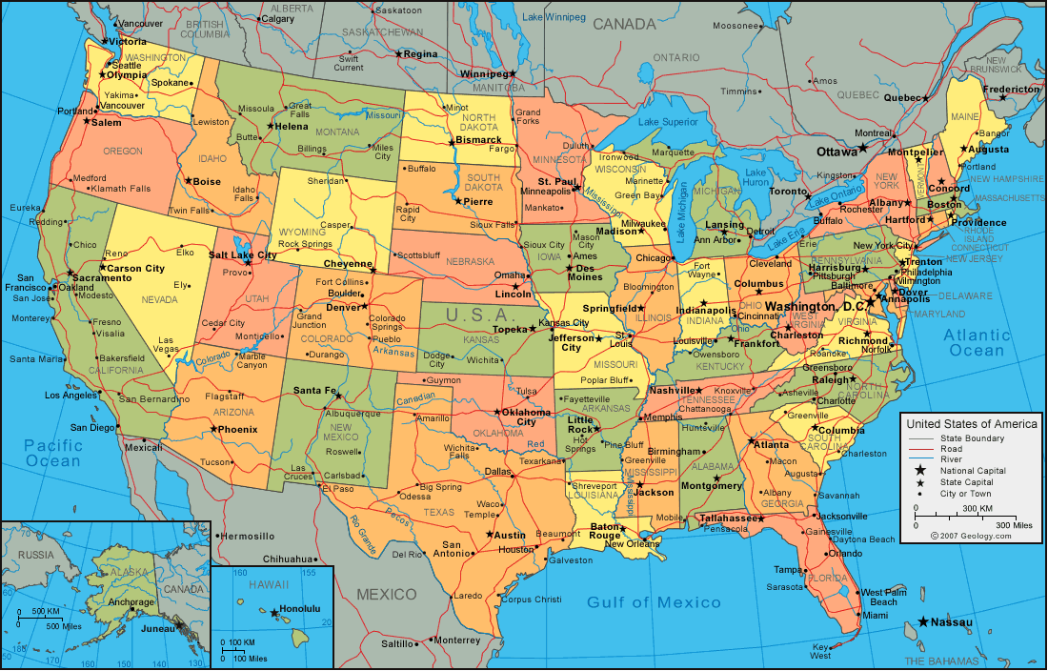
Client Reference
TIES
Proof-Of-Concept project Oct/Nov 2010
Replacing ASP.NET User Interface
EAE/AB Suite applications
4 large subsystems deployed across 11 Database servers (64bit)
front ended by12 web servers
Extensive use of SwitchTo
Notes:
TIES ran a Proof-Of-Concept project in October/November 2010, and based on that, they decided in 2011 to go ahead with Silverlight and the CTC solution.
They will be replacing their ASP.NET based interface with Silverlight.
TIES is currently in the process of migrating their systems to AB Suite and the User Interface upgrade will be rolled out starting from July.

Slide 18
In Summary…
More information available online
Free trial version available for download
Free remote assistance for Proof-Of-Concept projects
Contact: ngebauer@ClientTools.com.au
www.ClientTools.com.au
Notes:
Silverlight is a great environment that is well suited for business applications like EAE and AB Suite as it provides a much better opportunity to deliver a good and exciting interface compared with ASP.NET.
On the CTC Web Site there is more information and details about all the features of all the generators, and free evaluation versions for download.

