Slide 1
Experience the CTC Smart Client Solution Environment
Client
Tools
Consultancy
Niels Gebauer
Director
Client Tools Consultancy
ngebauer@ClientTools.com.au
Lab Session
Notes:
In this lab session you will get to:
specify/configure some typical and easy enhancements to the forms using the CTC Configurator,
generate a Smart Client user interface using the generator,
run the Smart Client user interface.

Slide 2
Agenda
Introduction to the Environment
Exercise 1: Remove Foreground/Background on Buttons
Exercise 2: Replace Date Fields with Date Picker
Exercise 3: Replace List Box with Data Grid
Exercise 4: Configure CopyFrom as Grid

Slide 3
The Environment
.NET 3.5 SP1 or higher
IIS 5.0 or higher
IE 8/9/10, Chrome 26+, Safari 5+, Firefox 20+
Visual Studio 2008 SP1 or Visual Studio 2010 SP1
EAE 3.3, AB Suite 1.2, AB Suite 2.0 or AB Suite 3.0
Component Enabler for .NET
CTC Smart Client Generator
SampleABS_CTCLab Model loaded into EAE or AB Suite

Slide 4
Exercise 1: Remove Foreground/Background on Buttons
Start the CTC Configurator
Specify the Push Button properties:
Right click on the bundle node and select Control Specifications/Add Control Specification
In the property pane, click on the ControlName property to get the dropdown arrow and click arrow to open the dropdown list
From the dropdown list, select PushButtonControl
Click on the ControlProperties property to get the ellipsis button and open the Properties Editor
Remove color and background-color properties
Click OK to close the Properties Editor
Click the Save icon to save this configuration
Close the CTC Configurator
Run the CTC Smart Client Generator

Slide 5
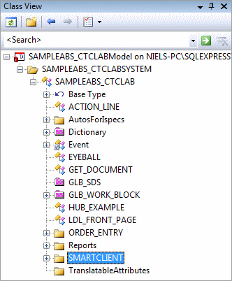
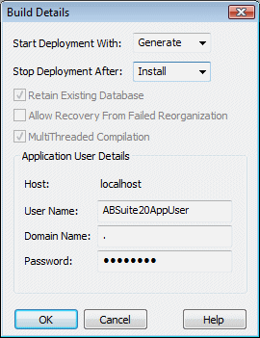
Run the CTC Smart Client Generator
Open the AB Suite SampleABS_CTCLab Model in Visual Studio or click on the desktop shortcut
In Class View, right click on the SMARTCLIENT bundle node and select Rebuild
In the Build Details dialog, enter Password
Click OK to start the CTC Smart Client Generator
Wait for the generate to finish
Run the generated Smart Client UI application

Slide 6
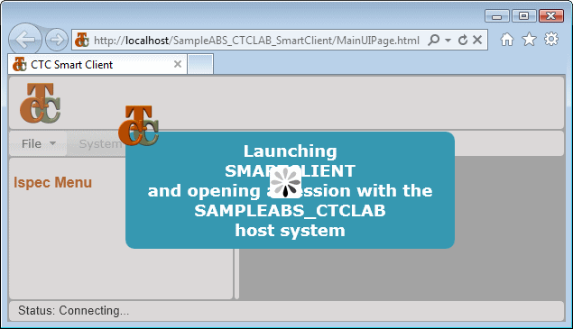
Run the Smart Client UI Application
Start a browser (Internet Explorer) or click on the desktop shortcut
Enter URL: http://localhost/SampleABS_CTCLAB_SmartClient/

Slide 7
Exercise 2: Replace Date Fields with Date Picker
Start the CTC Configurator
Substitute Date Fields with Date Picker:
Right click on the bundle node and select Control Substitutions/Add Control Substitution
In the property pane, click on the ControlName property and open the dropdown list
From the dropdown list, select TextBoxControl
Click on the SubstituteWith property and open the dropdown list
From the dropdown list, select DatePickerControl
Click on the MatchOnField property and open the Expression Editor
In the Expression Editor window, drag and drop the IsTypeDate expression to the Match Expression box
Click OK to close the Expression Editor
Click the Save icon to save this configuration
Close the CTC Configurator
Run the CTC Smart Client Generator

Slide 8
Exercise 3: Replace List Box with Data Grid
Start the CTC Configurator
Add CUST ispec:
Right click on the bundle node and select Add Ispec
In the properties pane, click the Name property and open the dropdown list
From the dropdown list, select CUST
Substitute ListBox with DataGrid:
Right click on the ispec CUST node and select Control Substitutions/Add Control Substitution
In the property pane, click on the ControlName property and open the dropdown list
From the dropdown list, select ListBoxControl
Click on the SubstituteWith property and open the dropdown list
From the dropdown list, select DataGridControl
Continues

Slide 9
Exercise 3: Replace List Box with Data Grid
Continued
Specify the Data Grid properties:
Right click on the ispec CUST node and select Control Specifications/Add Control Specification
In the property pane, click on the ControlName property and open the dropdown list
From the dropdown list, select DataGridControl from -<Custom Controls>-
Click on the ControlProperties property and open the Properties Editor
Change columns line 1as follows: { header:’Name’, binding:’column1’, width:’120px’, canSort:true, textAlign:’left’ }
Change columns line 2 as follows: { header:’Region’, binding:’column2’, width:’110px’, canSort:true, textAlign:’left’ }
Click OK to close the Properties Editor
Click the Save icon to save this configuration
Close the CTC Configurator
Run the CTC Smart Client Generator

Slide 10
Exercise 3: Replace List Box with Data Grid
Using sub-column specification
column 1
column 2
S01
S02
S03
S04
S05
S06
S07
EAE/AB Suite
0-30
31-30
sub-column specification:
%2(0-30) %2(31-30)
key
column 1
column 2
Smart Client
S01
S02
S03
S04
S05
Change List.Columns property in Data Grid Control Specifications to:
List.Columns=“%2(0-30) %2(31-30)“

Slide 11
Exercise 4: Configure CopyFrom as Grid
Start the CTC Configurator
Configure CopyFrom properties:
Right click on the options node and select Add CopyFrom As Grid
Set CopyFromAsGrid property to True
Right click on the options node and select Add CopyFrom Auto Column Headers
Set CopyFromAutoColumnHeaders property to True
Click the Save icon to save this configuration
Close the CTC Configurator
Run the CTC Smart Client Generator

Slide 12
Wrapping up
More information available online
Free trial version available for download
Free remote assistance for proof of concept projects Contact: ngebauer@ClientTools.com.au
www.ClientTools.com.au

