Slide 1
Client
Tools
Consultancy
The slides contain brief notes
Some slides are animated and are best viewed in Slide Show Mode
Smart Client
for
Smart Devices
Niels Gebauer
Director
Client Tools Consultancy
ngebauer@ClientTools.com.au
Notes:
This presentation covers the new Smart Client Generator from CTC which will allow you to create a User Interface to your EAE and AB Suite applications that will run on any of the modern smart devices such as iPads & iPhones, Android Tablets & Phones, Windows Tablets & Phones and the traditional PCs & MAC desktops and laptops.

Slide 2
Client Tools Consultancy
Specializes in client interface solutions to customers using EAE and AB Suite systems
The company aim is to provide products and services that add value to EAE and AB Suite by enriching the End User Interface capabilities
Founded May 2007
Located in Adelaide, South Australia

Slide 3
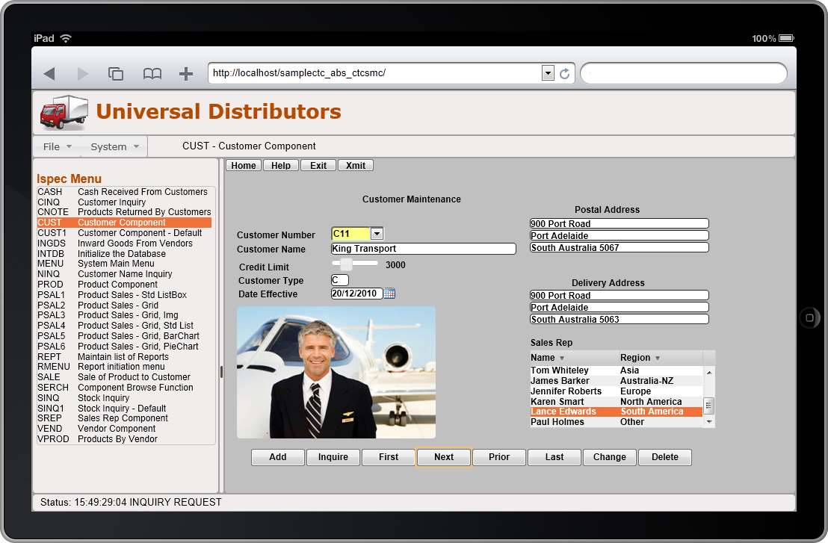
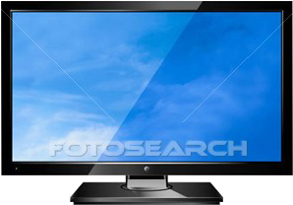
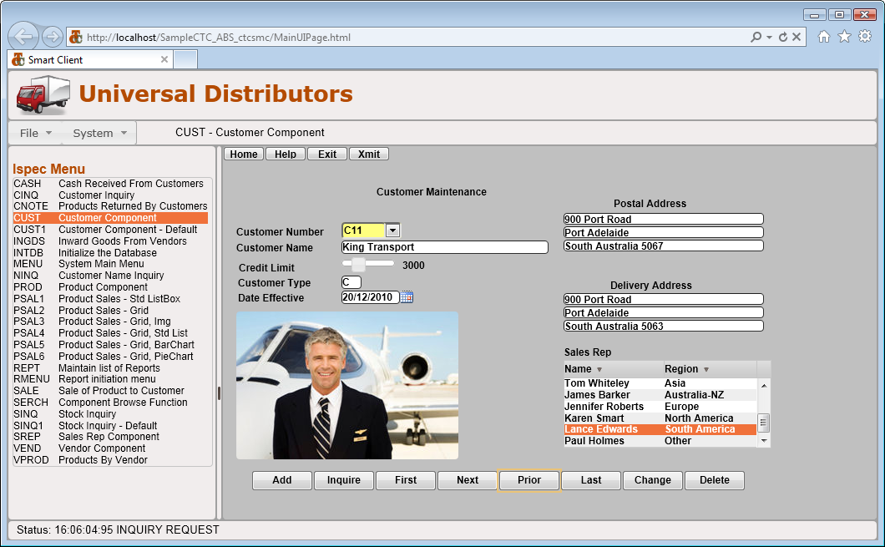
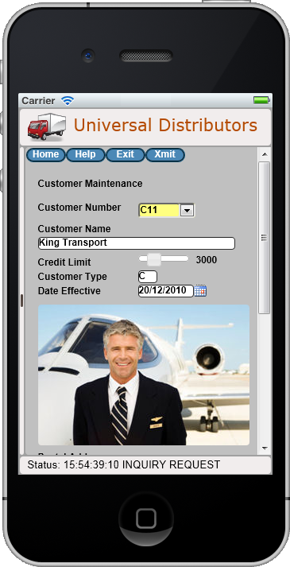
Agenda
The CTC Smart Client Environment
Smart Client Landscape
Generate Environment
Runtime Architecture
Demonstrations
Smart Client UI
Custom Controls
Copy From Grid
Smart Devices
PC – iPad - iPhone
The CTC Smart Client Environment
Smart Client Landscape
Generate Environment
Runtime Architecture
Demonstrations
Smart Client UI
Custom Controls
Copy From Grid
Smart Devices
PC – iPad - iPhone

Slide 4
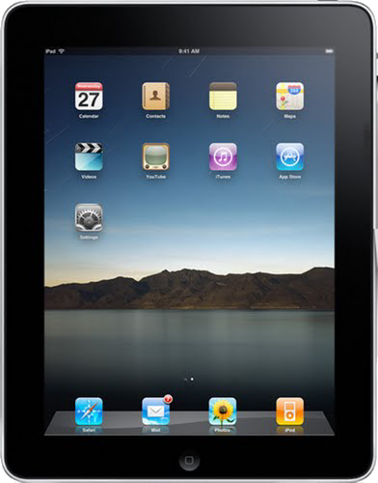
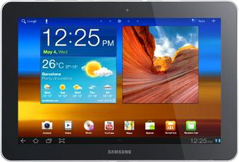
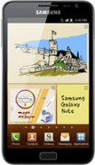
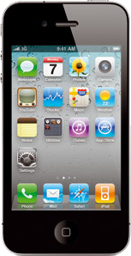
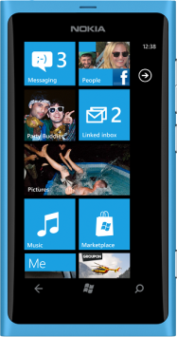
Smart Client Landscape
Tablets
Desktops/Laptops
Smart Phones
CSS3
+
JavaScript
Notes:
There are a large number of different Smart Devices available from different manufacturers. You have the traditional PCs– Desktops and Laptops, the smaller mobile tablets and the mobile smart phones.
CLICK
They use different operating systems. The dominating ones are Macintosh OS, Apples iOS for iPads and iPhones, Googles Android for tablets and phones, and Microsoft Windows for PCs, Tablets and Phones.
CLICK
In addition to that, they use different browsers. The four dominating ones are Safari by Apple, Internet Explorer by Microsoft, Chrome by Google and the open-source Firefox.
This variety of Operating Systems and Browser technologies provides a bit of a challenge when wanting to take advantage of these devices for accessing your EAE and AB Suite applications.
CLICK
But luckily they all have one thing in common and that is, they all support HTML 5 with CSS 3 and JavaScript.
CLICK
And that is exactly what the Smart Client Generator is targeting. The user interface application generated by the Smart Client Generator is purely based on HTML 5 and JavaScript. Nothing else. So it doesn’t require any proprietary plug-ins like Silverlight. The User Interface created by the Smart Client generator will run on any of these modern smart devices. So with one solution, you can target all of these devices.
CLICK
Although the browsers all support HTML 5, there are a few incompatibilities between the browsers. To help combat these differences, the Smart Client Generator takes advantage of the open-source jQuery JavaScript library. jQuery is the most widely used framework for achieving cross browser compatibility.

Slide 5
Generate Environment
CTC
Configurator
CTC
Config
XML DB
EAE
Model DB
Plug-In Generators
EAE
Developer
CTC ASP.NET Generator
CTC WCF Services Generator
CTC WPF Client Generator
CE
Generate
Environment
CTC Silverlight Generator
Plug-In
Generators
CTC
Smart Client
AB Suite
Developer
Generator
AB Suite
Model DB
Generated
Solution
Notes:
This is the familiar Generate Environment.
CLICK
The Smart Client generator is just another plug-in generator to the CE Environment, and as such, you run the Smart Client generator in exactly the same way as you run all other Component Enabler Generators.
The CTC Generators use the CTC Configurator. It provides a graphical interface allowing you to configure the behavior of the generators, which gives you control over what is generated.
With EAE and AB Suite, you paint a general look and feel of the forms, not for any specific User Interface. With the CTC Configurator, you then specialize the forms for a specific User Interface Environment, such as Smart Client, Silverlight, WPF or ASP.NET. For example, with the CTC Configurator, you add in Date Pickers, Data Grids and other features that are specific to the User Interface you are targeting.

Slide 6
Runtime Architecture of
Generated Smart Client Application
IIS Web Server
Unisys CE .NET
Generated UI Application
EAE/AB Suite
Host Systems
Internet
Intranet
Smart Client Application
IIS
Smart Client View Controller
Smart Client Services
Data Items
Views Navigation
Forms Download
Forms Display
Event Handling
Data Binding
CE Proxy
Connect/Transact
Ispec Model
List data
Status Line
Session State
Host
Communication
Unisys Component Enabler
Local Storage
Downloaded
Ispec Views &
View Models
Views/Forms Download
Generated
Ispec Views &
View Models
Notes:
The runtime environment is a traditional three tier architecture.
On the client side, we have the different types of Smart Devices – PCs and MACs, Tablets and Mobile Phones – each running their preferred browser and OS.
On the middle tier, there is the Web Server with IIS. This is where you deploy the generated Smart Client Application to. On the web server, we have the Unisys Component Enabler that handles all the communication with the Host EAE or AB Suite systems.
and finally we have the host system, which can be any computer on which you currently run your systems.
CLICK
This gives a little more detailed look at some of the components involved.
This architecture reflects how modern rich web sites based on HTML 5 are architected.
One of the first things that happens when a user for the very first time enters the URL to the application on the web site, is the Main UI Application is downloaded together with the Smart Client View Controller. This is a JavaScript module that, on the client side, manages everything to do with the forms/views, such as automatic downloading, displaying, handling of various events and other things such as data-binding for getting data in and out of the forms. This also ensures the session with the Web Server never times out.
This also includes a CE Proxy module, that implements the necessary functions required to communicate with Component Enabler on the Web Server.
On the Web Server, there is a Smart Client Services module that implements the services that are necessary for the Proxy module to communicate with Component Enabler and the host system.

Slide 7
Smart Client
Runtime Environment
Efficient Environment
Automatic forms distribution
Forms are downloaded once only and cached until changed
Minimum resources required on the Web Server
Forms are processed and rendered locally on the Client
Only data is exchanged with the Web Server
End-User Experience
Desktop-like experience
Immediate feedback to user actions
Good performance
Transaction Size (Sample System CUST Ispec) in Bytes | ASP.NET (AJAX) | Smart Client
Request Message – Client to Web Server | 1,121- (1,121) | 782
Response Message – Web Server to Client | 17,568- (16,837) | 2,352
Notes:
The Smart Client Environment is a very efficient environment:
Forms are distributed automatically to the client and cached locally on the client. So, on any subsequent use of a form, it is loaded directly from the local storage.
Forms are processed locally on the client and only data is exchanged with the web server. A form is rendered once only when it is opened and on every subsequent transaction, the controls on the form are updated directly with data from the transaction.
Behind the scenes it uses AJAX for communicating with the web server, which makes it very efficient.
Compared with ASP.NET, a Smart Client application uses much less resources on the web server. ASP.NET is a very resource hungry environment because it processes and re-creates the forms on the server on every request and this easily leads to the web server becoming a bottle neck.
As a comparison, shown here is the size of a transaction of the CUST ispec from the Sample system. We can see that the size of the request being sent into the server is about 30% smaller for the Smart Client. The size of the reply message coming back from the server is about 85% smaller for Smart Client. That’s because the Smart Client application sends only the actual data back, not the entire form. So that is a significant difference and this is one of the reasons the users will experience a much better response time with the Smart Client.
Processing the forms locally on the client, as the Smart Client does, leads to a better End User experience. They get a desktop like experience with immediate feedback to user actions and a great performance.

Slide 8
Agenda
The CTC Smart Client Environment
Smart Client Landscape
Generate Environment
Runtime Architecture
Demonstrations
Smart Client UI
Custom Controls
Copy From Grid
Smart Devices
PC – iPad - iPhone

Slide 9
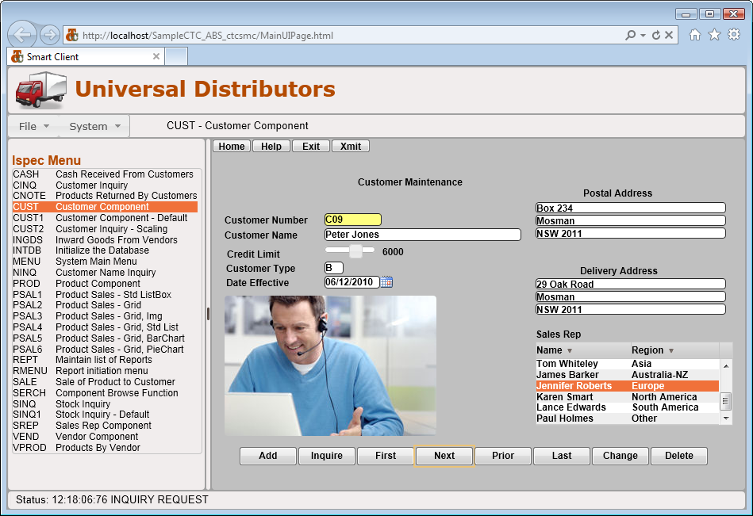
Demo
Sample Smart Client UI
Notes:
This demo shows an example of a typical Smart Client User Interface Application on a PC.
This is a typical interface. It can be customized to suit local requirements.
At the top is a banner.
Then a menu bar with a number of default functions. All of these are part of the default application that is delivered with the generator. That makes it easy to pick and choose what is to be included in your application.
In the left hand panel, there is a typical list of transactions available to the user. This is created dynamically based on the ispecs that have been included in the bundle.
This slide shows the CUST ispec with the Date Picker, a Data Grid, rounded controls and rollover effect on buttons and textboxes.
The following slides will show how some of this is done.

Slide 10
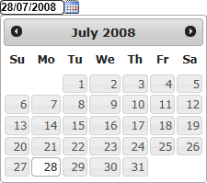
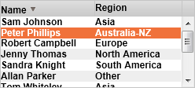
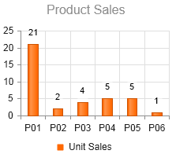
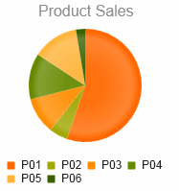
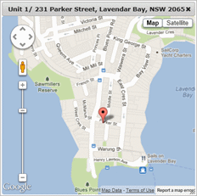
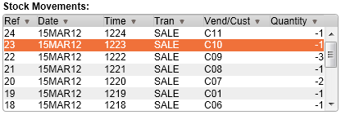
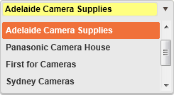
Custom Controls
Date Picker
DataGrid
Charting
Column Sorting
Alternating row colors
Map Popup
Chart Types
Column
Bar
Pie
Line
Slider
CopyFrom List
Combo Box
Additional Controls
Additional custom controls can be
added by customers or CTC.
Notes:
This slides covers some of the Custom Controls that are included with the generator.
Custom controls are an essential part of being able to enhance the forms.
Custom Controls are used when you want to replace controls that you have painted on the forms. For example, a DatePicker control can be used instead of a textbox that displays date fields, and a DataGrid control can be used instead of a listbox.
You are not limited to just these custom controls. The CTC solution allows you to add your own Custom Controls.
The source code of the Custom Controls is included with the generator and you can use that as a starting point for creating your own controls.
Contact CTC to get assistance with creating additional custom controls to suit any specific requirements.

Slide 11
Third Party Controls
Notes:
You can also use controls from the third party tool vendors. There are a number of third parties that offer controls for HTML5, Silverlight, ASP.NET and WPF.
The CTC solution is designed to allow you to take advantage of these, and add them as Custom Controls, to suit your requirements.

Slide 12
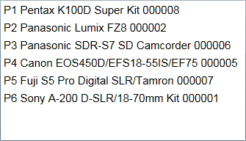
Demo
Custom Controls
Notes:
This slide shows how the painted forms can be enhanced and how to improve the user interface by taking advantage of Custom Controls.
It shows:
Replacing Text Box with the Date Picker control
Replacing Text Box with a Slider control
Replacing List Box with a Data Grid specifying Column Headers and Column Sorting
Replacing List Box with a Chart control (Column Chart and Pie Chart)
Generating Copy From as a Data Grid with automatic column headers
Note: These enhancements have all been done without the need for any programming and without making any changes to the EAE and AB Suite application.

Slide 13
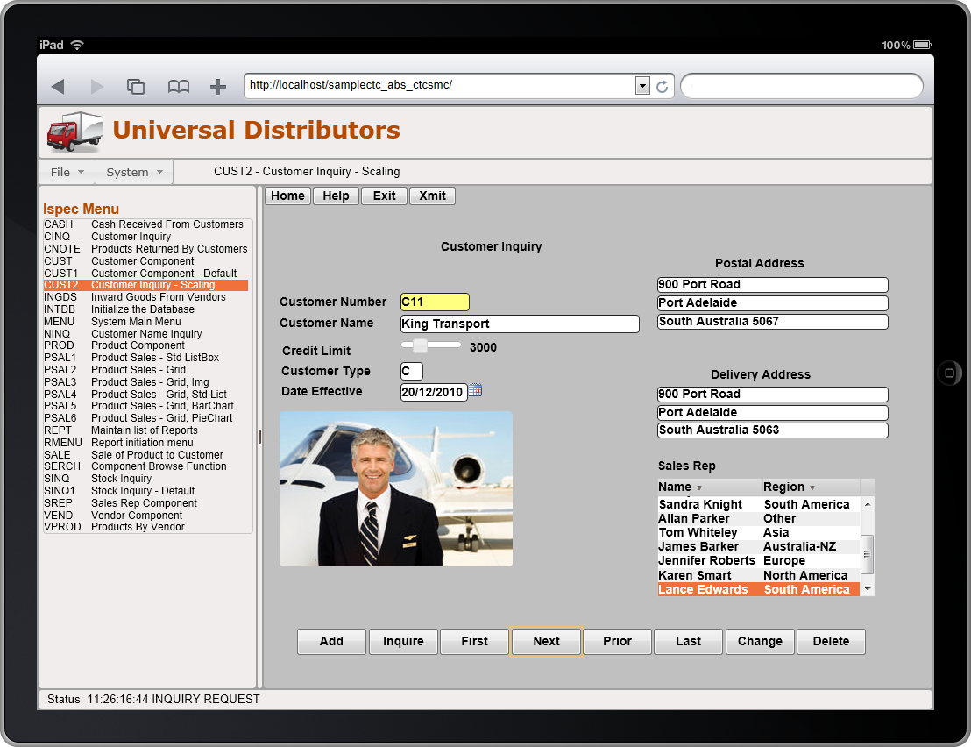
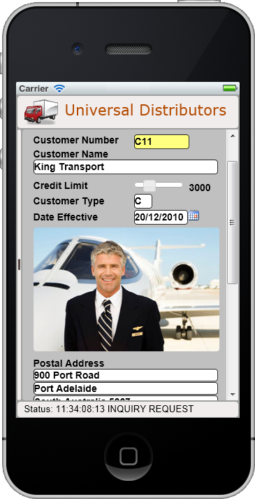
Demo
Tablets:
iPad
Smart Phones: iPhone
Scaling & Alternate Views
Notes:
The demos depicted in the previous slides have been run from a traditional PC.
This slide shows what the same interface looks like when it is run from smart devices such as iPad and iPhone. It illustrates how features such as Scaling and Alternate View can help improve the usability of the forms on the smaller devices.
Starting with the iPad:
The screen size of a tablet such as the iPad may be adequate to run most of your forms without any major changes.
Since these devices are touch screens, it is important to consider whether the size of the controls are adequate for selecting with the finger.
The CUST ispec on the slide, in the iPad View, shows how the controls have been scaled up using the Scaling options. With the scaling options you can scale the size (height/width) and position of the controls. So with this you can enhance the usability of the forms without making any changes to the forms in EAE or AB Suite.
Following on with the iPhone:
The screen size of smart phones is much smaller and obviously that presents some usability issues that need to be considered.
A form such as the CUST ispec is clearly too big for smaller screens. There is too much scrolling in all directions. Scrolling should be kept to a minimum and when it cannot be avoided, scrolling up and down is the preferred direction.
One of the major issues we are dealing with here is that controls on the forms created with the EAE and AB Suite painters are painted in fixed positions, which can cause a problem when deploying the forms on devices with smaller screen sizes.
The layout of a form like this needs to be rearranged in order for it to be useful on a small device like the phone.
There are different ways this can be done. One option may be to add a second language in EAE or AB Suite and paint the forms in that language for mobile devices.
Another option is to use the CTC Alternate Views feature, which will automatically create a copy of the generated form. You can then rearrange the layout in a painter such as the Visual Studio HTML painter outside of EAE and AB Suite. This option could be used to avoid the need to make any changes to the forms in EAE or AB Suite. With a regenerate, forms created with the Alternate View option will not be overwritten.
The CUST ispec shown on the slide, in the iPhone View, has been created using the ‘Alternate View’ option.
The form has then been opened with the Visual Studio HTML painter and the layout has been changed. It is still the same ispec with the same data going back and forth to the host system.
When deploying forms on Mobile devices, consider whether the forms are appropriate for these devices. Inquiry screens are more appropriate than data-entry screens.

Slide 14
CTC Smart Client Benefits
One solution targets many devices
PC’s and MAC’s
Apple iPads and iPhones
Android Tablets and Phones
Windows Tablets and Phones
Use industry standards
HTML 5 + CSS 3 and JavaScript
No dependency on proprietary plug-ins
Efficient environment – leading to good end user satisfaction
Forms are processed and rendered locally on the Client
Minimum resources required on Web Server
Flexible and highly customizable to suit local requirements
Notes:
These are a few of the benefits of the Smart Client generator.
With the Smart Client solution you can target any of the modern smart devices listed here.
It is based on industry standards, such as HTML 5, CSS 3 and JavaScript – and it does not rely on proprietary plug-ins such as Silverlight which makes it very portable across these devices.
The architecture makes it a very efficient environment, which is important for achieving a good End User satisfaction.
you can customize just about anything to suit individual local requirements.

Slide 15
Client References
Banco República del Uruguay
McGowan Computer Associates
George McGowan
gmcgowanjr@aol.com
Notes:
These are clients of CTC.
Banco República del Uruguay have been a client of CTC for nearly 4 years. They are running in full production using Silverlight for their entire banking system.
TIES is an AB Suite site in US and they are using the Smart Client Generator and have been running in production for about 6 month.
United Fire Group is an insurance company in the US. They are using AB Suite and the Smart Client Generator. Not in production yet.
Wright & Filippis is a US Medical Supply Company. They started in 2011 and are using Silverlight. They went from Proof-Of-Concept to production in the space of 4 weeks. They evaluated the CTC Silverlight solution over 2 weeks and decided to go ahead. Two week later, they were in production with their Diabetics reordering system, which goes directly out to the public on the internet.
George McGowan Computer Associates is a US consultancy company, providing services to many EAE and AB Suite clients in the US. They are working with the CTC Generators.

Slide 16
Wrapping up…
More information available online
Free trial version available for download
Free remote assistance for Proof-Of-Concept projects Contact: ngebauer@ClientTools.com.au
www.ClientTools.com.au
Notes:
The Smart Client generator provides a great environment that is well suited for business applications like EAE and AB Suite.
Refer to the CTC Web Site for more information and details about all the features of all the generators.
To try any of the generators, there are free evaluation versions available on the web site. Remote assistance can be provided, free of charge, during your evaluation or a Proof-Of-Concept project.

Slide 17
Client
Tools
Consultancy
www.ClientTools.com.au

